Slide 1


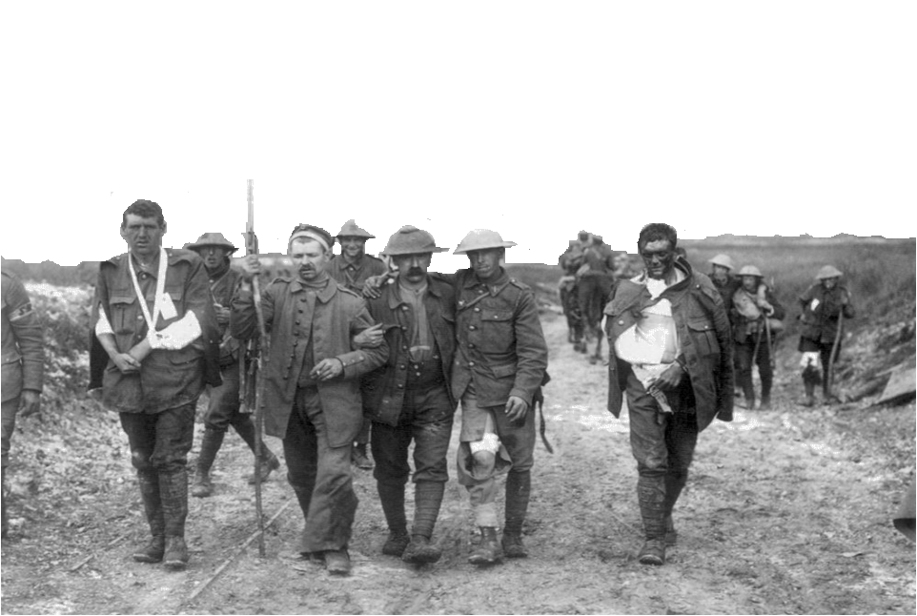

Slide 2
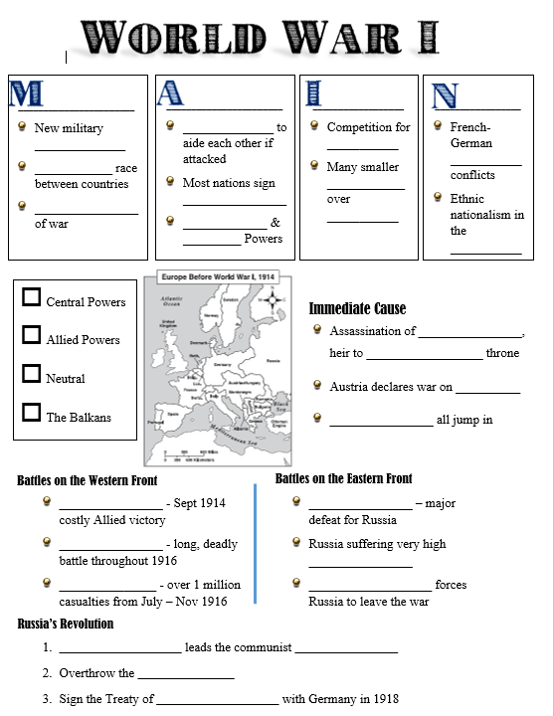
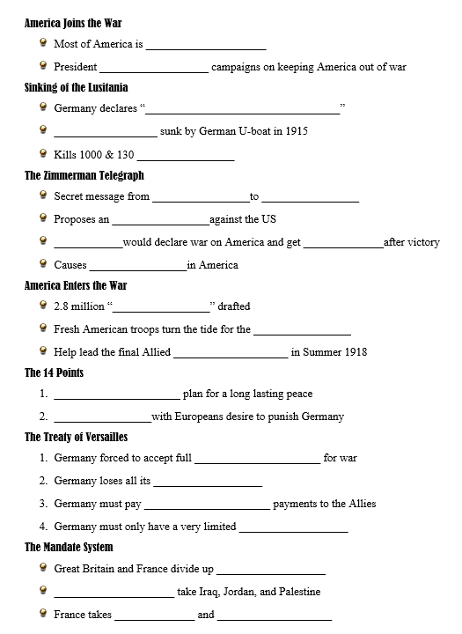

Thank you!
Thank you so much for purchasing this product for your classroom! I very much appreciate your support and business. Please, however, do not post this resource to any webpage, blog, Weebly page or Youtube. This is a violation of our Terms of Use.
Click below for the Guided Outline Notes:
https://s3.amazonaws.com/guidednotes/01+-+World+War+1+Notes+Page.docx
Note: If the link above does not immediately download the Word Doc check your internet settings. You likely have pop ups blocked, a firewall, or another security setting preventing the download.
Flipped Classroom Youtube Video of this presentation:
https://youtu.be/Of_elYIz3mk

Slide 3
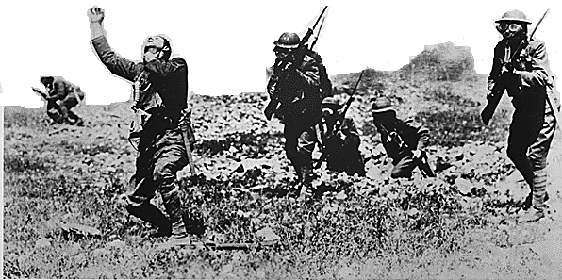
M
ilitarism
A
Causes
lliances
I
mperialism
N
ationalism

Slide 4
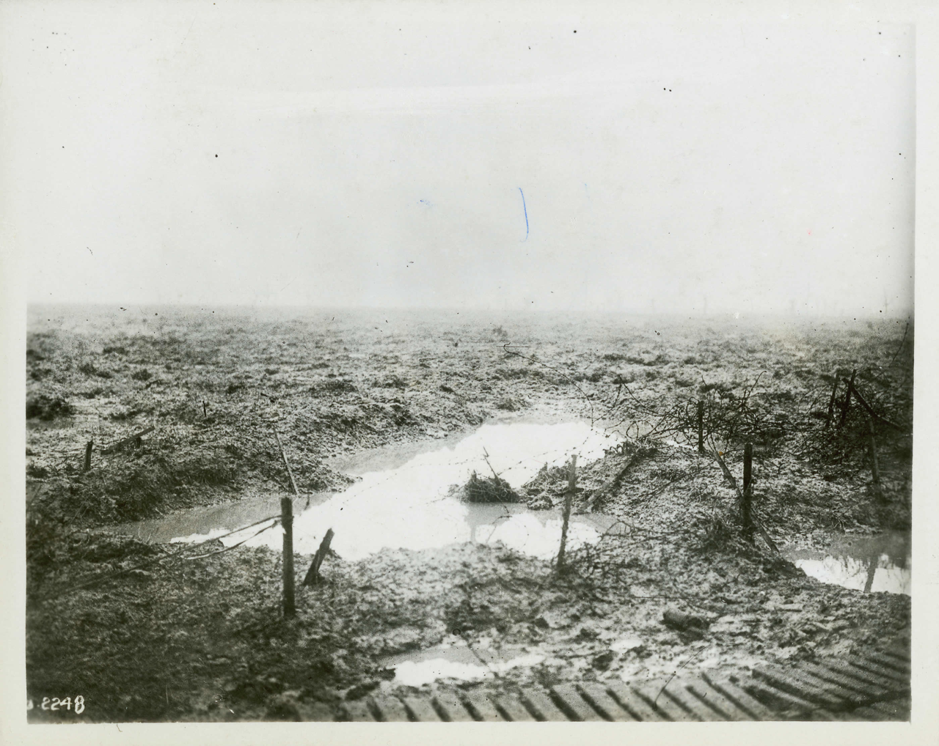
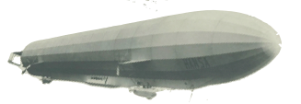


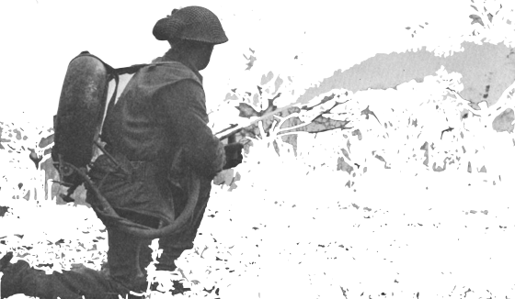
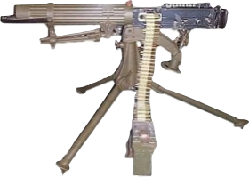




Can you find all the new technologies of war?

Slide 5
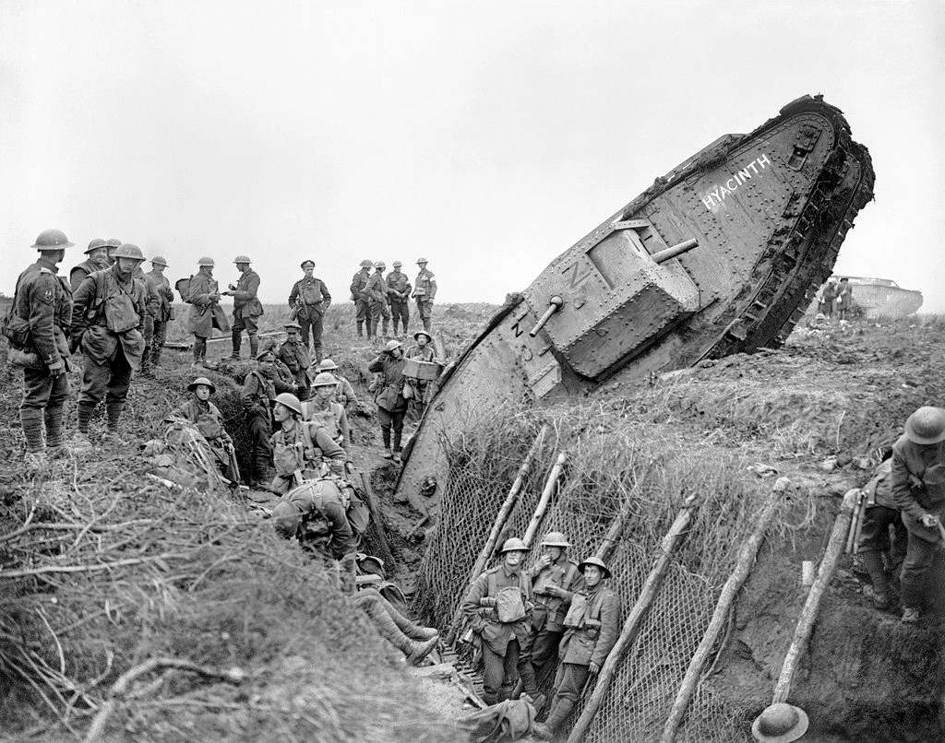

Militarism
New military technologies
Arms race between countries
Glorification of war

Slide 6
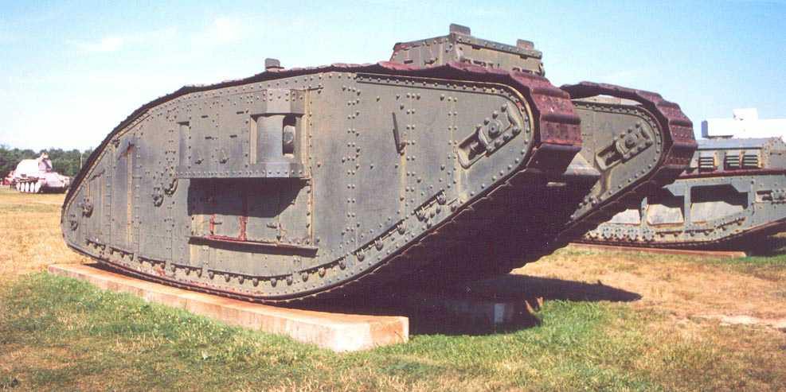

Slide 7
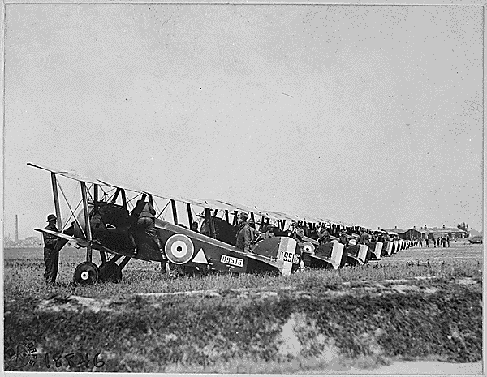

Slide 8
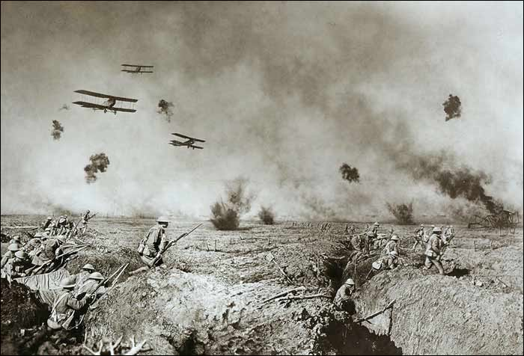

Slide 9
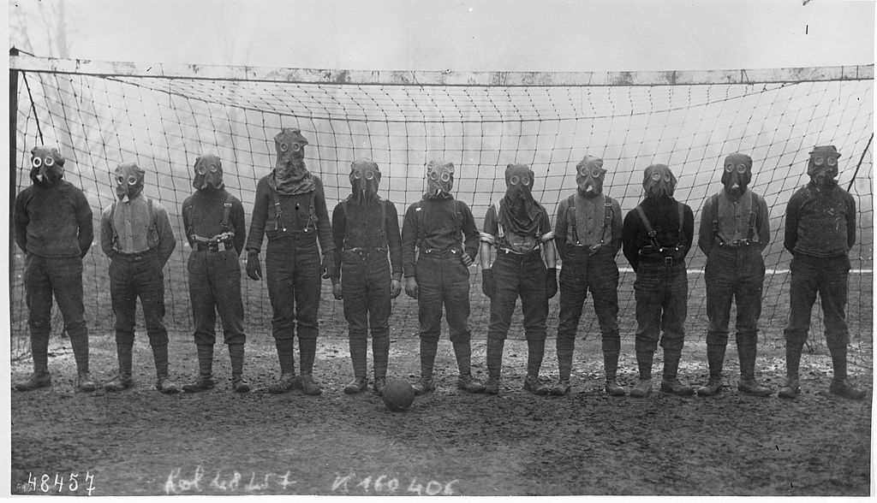

Slide 10
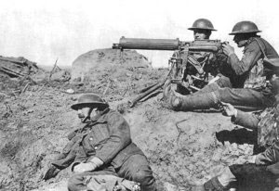
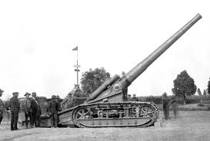
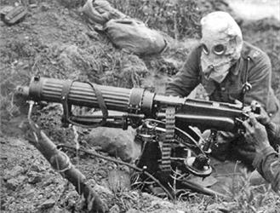

Slide 11
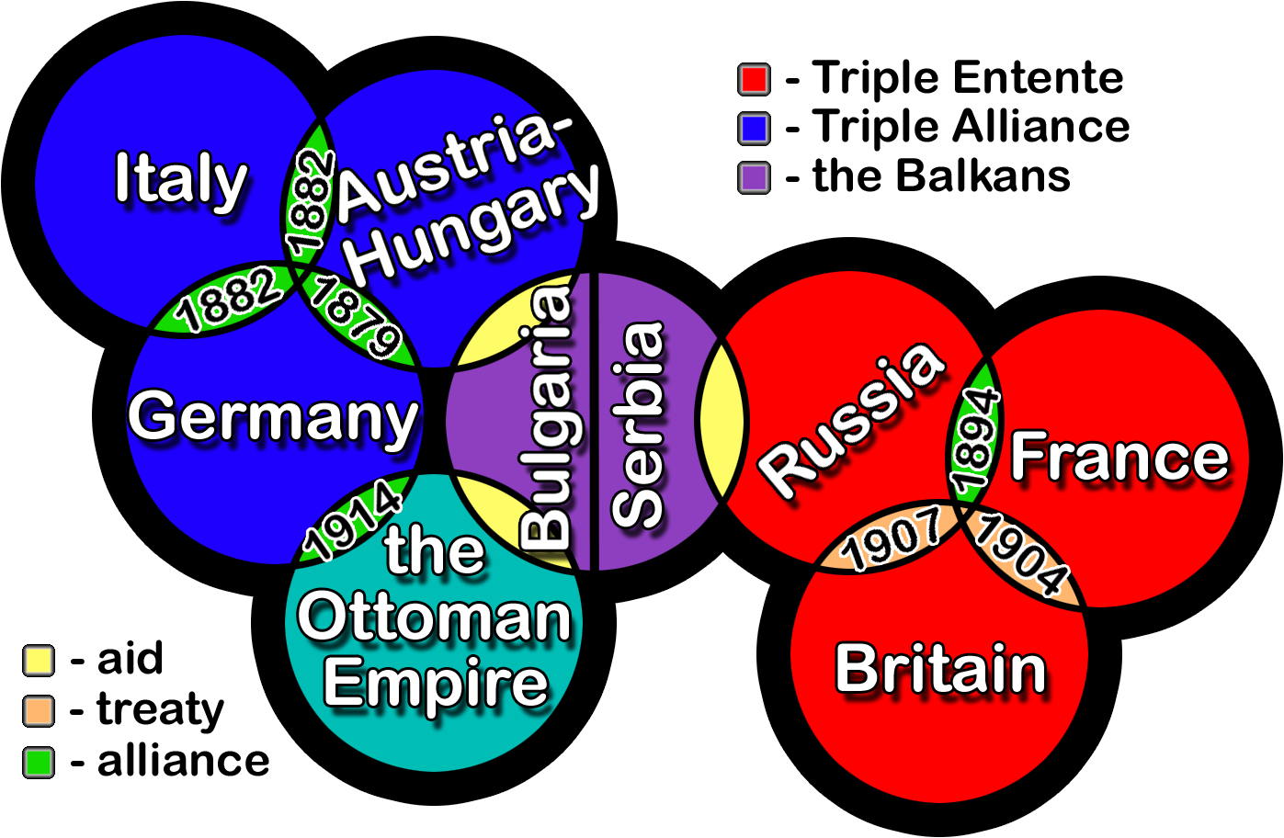
Alliances
Agreements to
aide each
other if
attacked
Most nations
sign secret
alliances
Allies & Central Powers

Slide 12
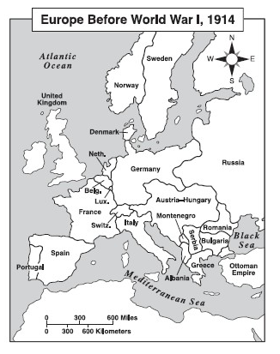



Key
Central Powers
Allied Powers
Neutral
The Balkans

Slide 13
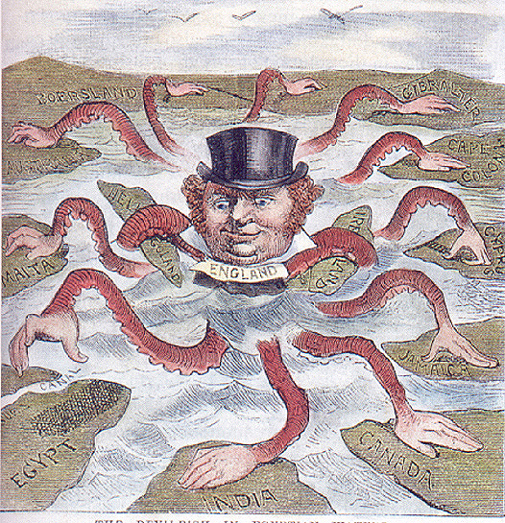
Imperialism
Competition for colonies
Many smaller wars over territory

Slide 14
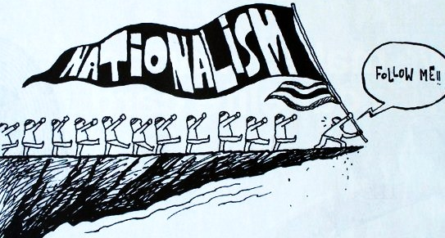
Nationalism
French-German border conflicts
Ethnic nationalism in the Balkans

Slide 15
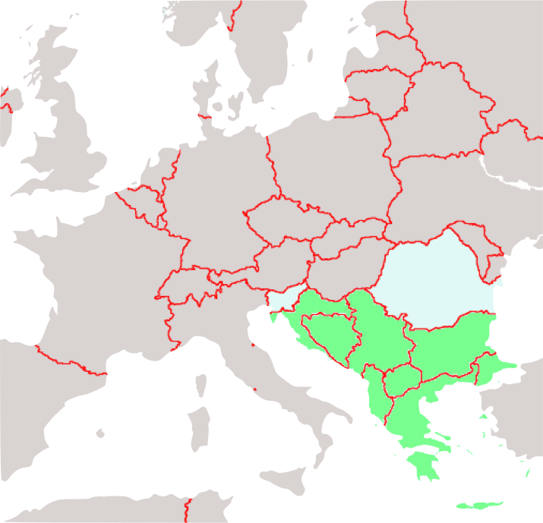
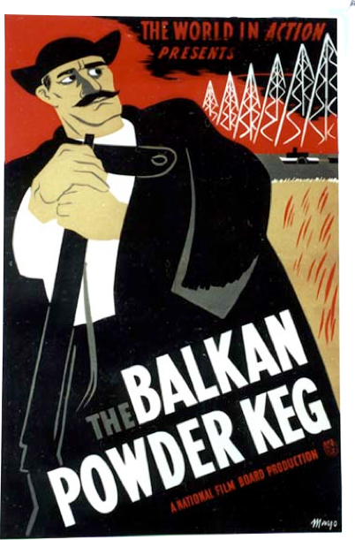
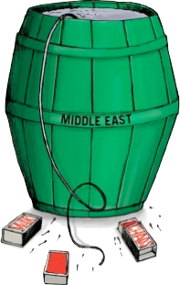
Balkans

Slide 16
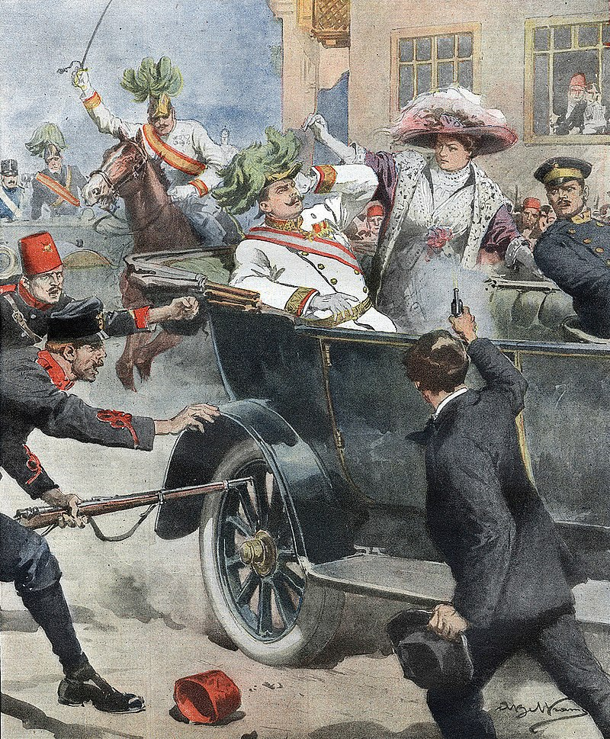
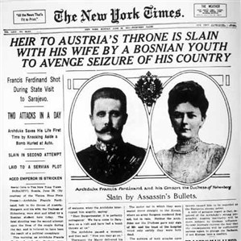
Immediate Cause
Assassination of Franz Ferdinand, heir to Austria-Hungary’s throne
Austria declares
war on Serbia
Allies all jump in

Slide 17
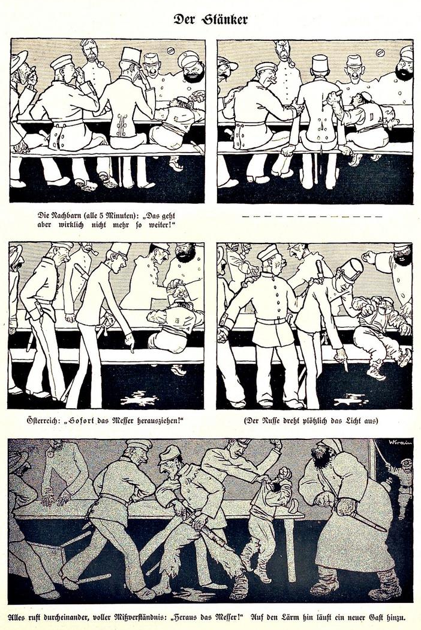
“The Troublemaker”
Notes:
Political cartoon titled "Der Stänker" ("The Troublemaker") that was published in the German satirical magazine Kladderadatsch on 9 August 1914, depicting the nations of Europe sitting at a table. (1st panel) The Central Powers hold their noses in distaste as tiny Serbia joins the table, while Russia reacts with joy. (2) Serbia stabs Austria-Hungary, to everyone's apparent shock. Germany immediately offers support to Austria. (3) Austria demands satisfaction from Serbia, while a relaxed Germany with hands in its pockets doesn't notice Russia and France come to agreement in the background. (4) Austria manhandles Serbia, while an alarmed Germany looks to an angry Russia and presumably makes an agreement with the Ottoman Empire, and France tries to talk to Britain. (5) A general brawl erupts with Germany and France immediately confronting each other, as Britain looks on in dismay. (The cartoon may have been drawn before the British declaration of war.) To the right, another combatant threatens to join from the darkness.

Slide 18
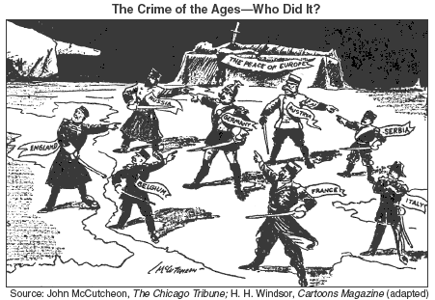

Slide 19
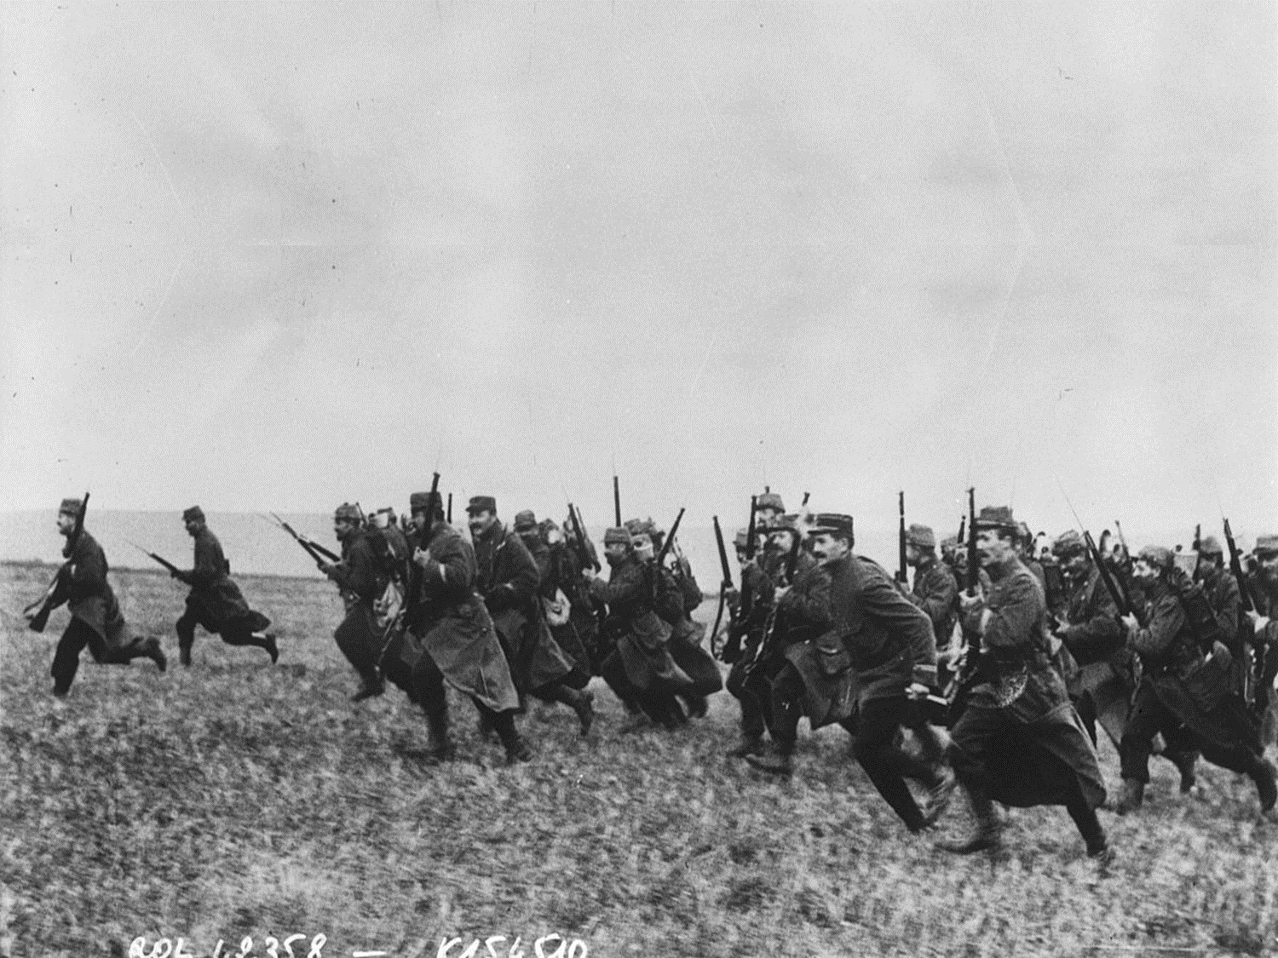
Battles on the Western Front
The Marne - Sept 1914 costly Allied victory
Verdun - long, deadly battle throughout 1916
Notes:
A French lieutenant at Verdun, who would be killed by a shell, wrote in his diary on 23 May 1916, "Humanity is mad. It must be mad to do what it is doing. What a massacre! What scenes of horror and carnage! I cannot find words to translate my impressions. Hell cannot be so terrible. Men are mad!

Slide 20
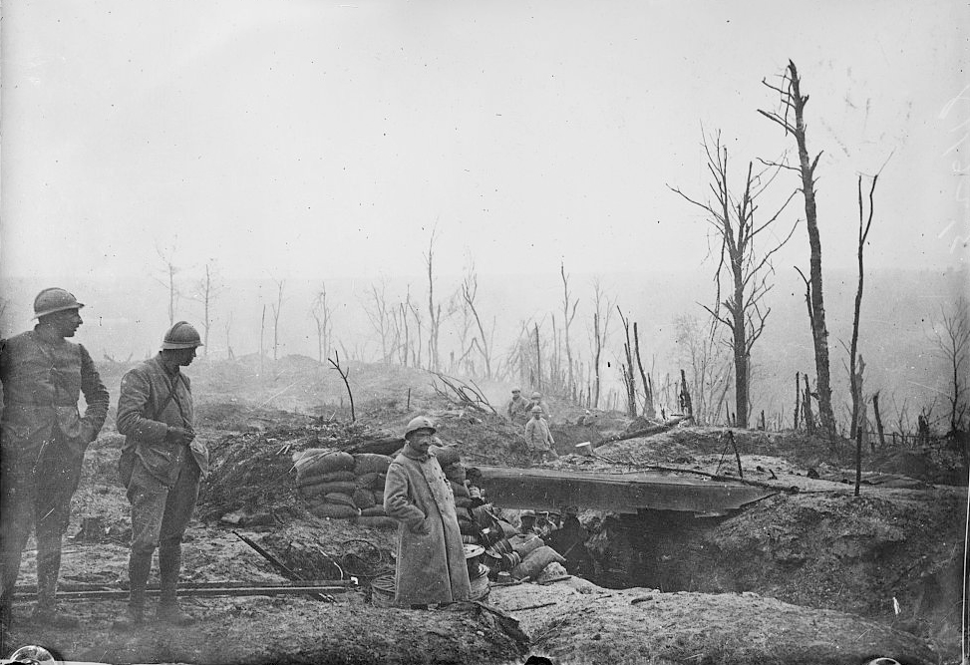
Battles on the Western Front
The Somme - over 1 million casualties from July – Nov 1916
Notes:
“Somme. The whole history of the world cannot contain a more ghastly word.”
— Friedrich Steinbrecher

Slide 21
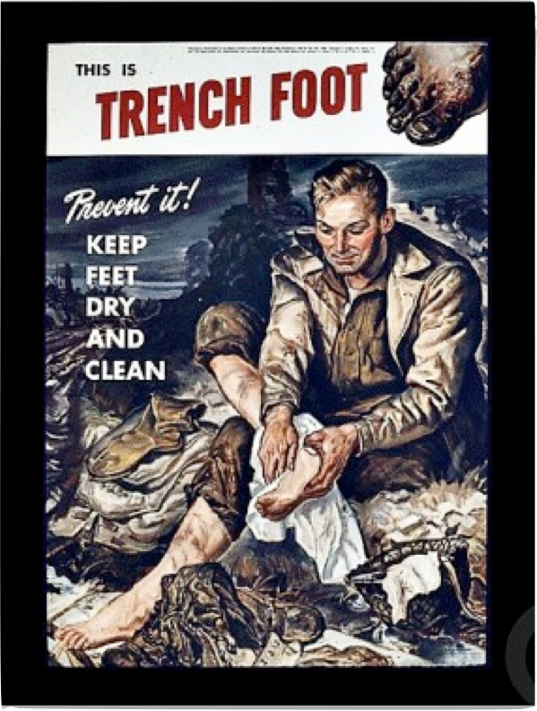
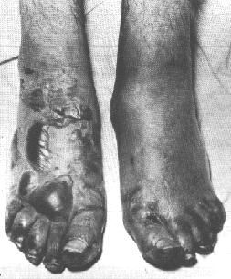
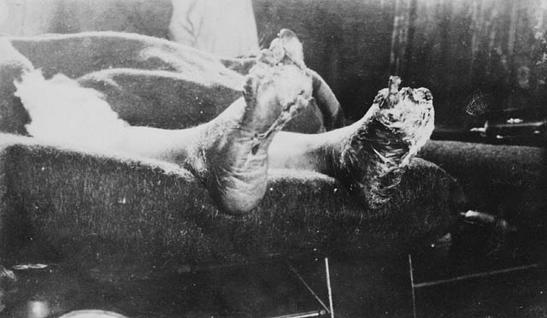

Slide 22
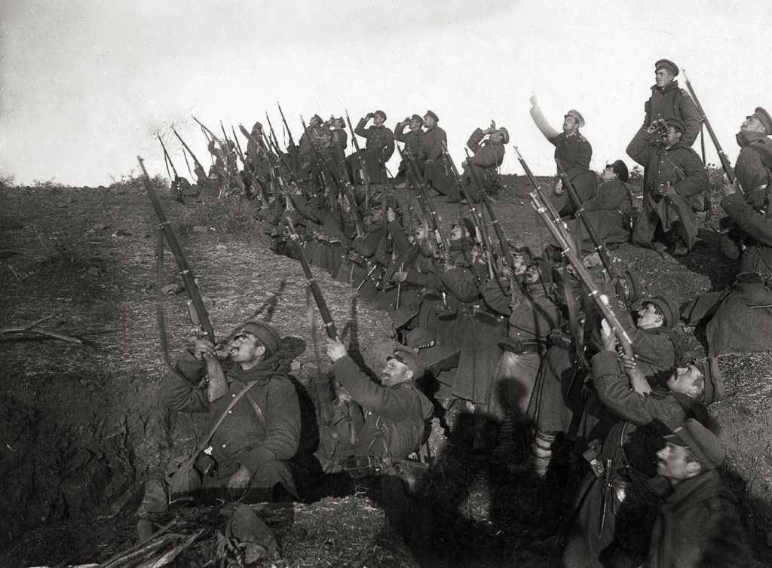
Battles on the Eastern Front
Battle of Tannenberg – major defeat for Russia
Russia suffering very high casualties
Revolution of 1917 forces Russia to leave the war

Slide 23
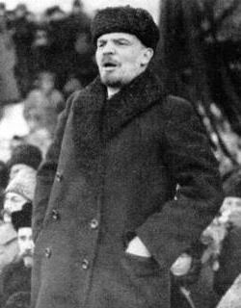
Russia’s Revolution
Vladimir Lenin leads the communist Bolsheviks
Overthrow the Czar
Sign the Treaty of Brest-Litovsk with Germany in 1918

Slide 24
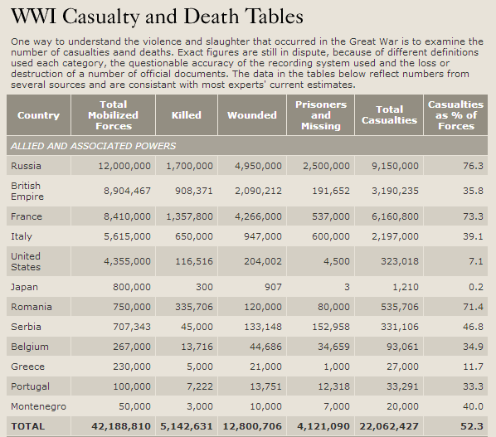
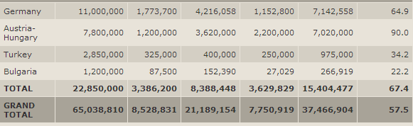

Slide 25
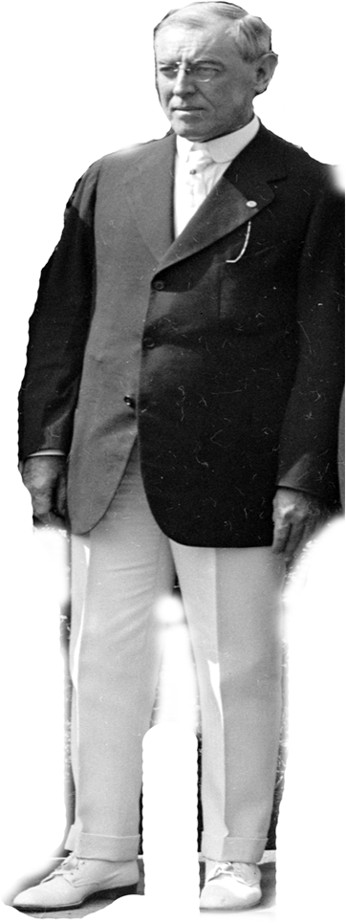
America Joins the War
Most of America is isolationist
President Wilson campaigns on keeping America out of war

Slide 26
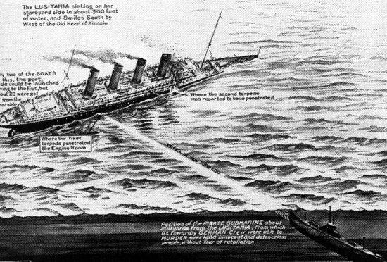

Slide 27
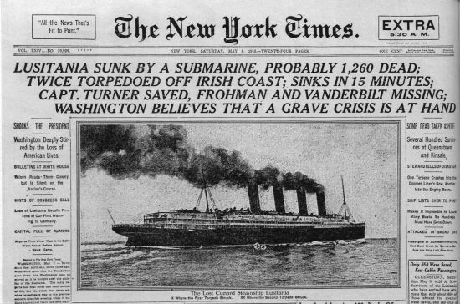

Slide 28
Sinking of the Lusitania
Germany declares “unrestricted submarine warfare”
Lusitania sunk by German
U-boat in 1915
Kills 1000 & 130 Americans
Germany must apologize, stop targeting peaceful ships
and America will stay neutral.

Slide 29
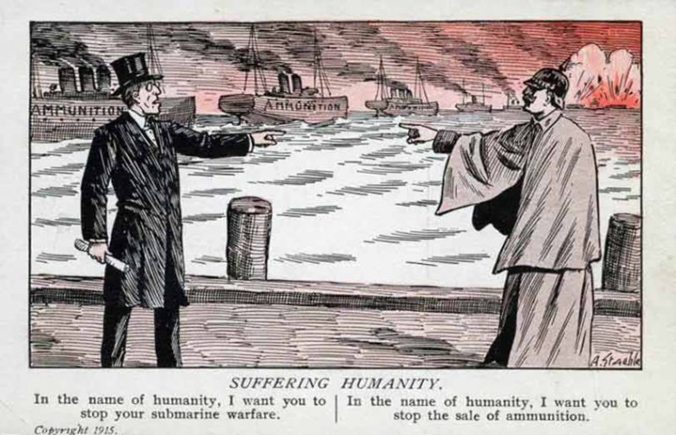

Slide 30
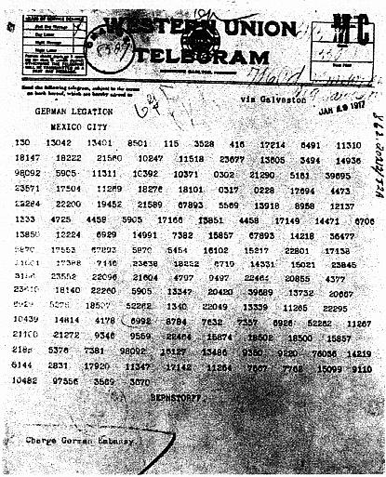
The Zimmerman Telegraph

Slide 31
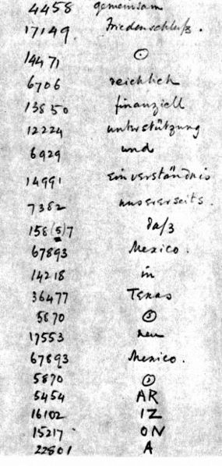
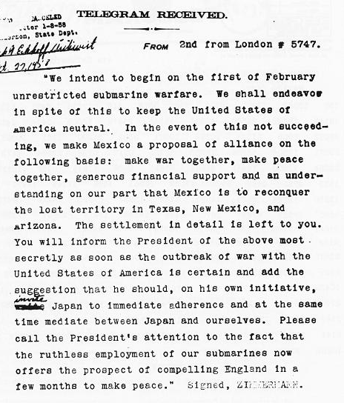

Slide 32
The Zimmerman Telegraph
Secret message from Germany to Mexico
Proposes an alliance against the US
Mexico would declare war on America and get lost territory after victory
Causes an outrage in America
What should President Wilson do this time?

Slide 33
The world must be made safe for democracy. Its
peace must be
planted upon the
tested foundations
of political liberty.
-Woodrow Wilson

Slide 34
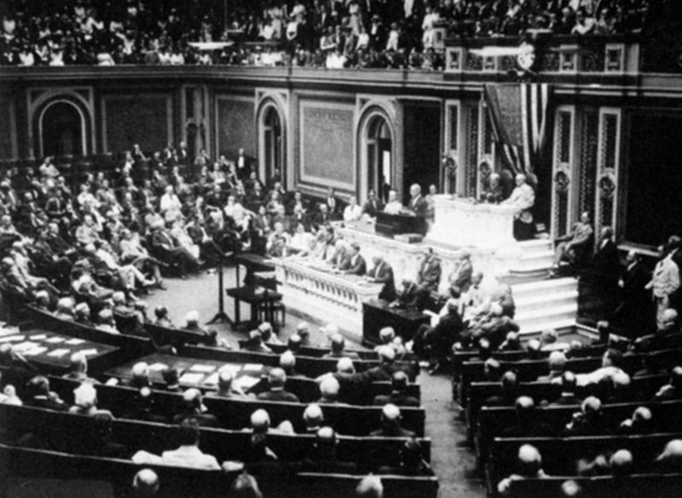
The Zimmerman Telegraph
Congress officially declares war on Germany in April 1917.

Slide 35
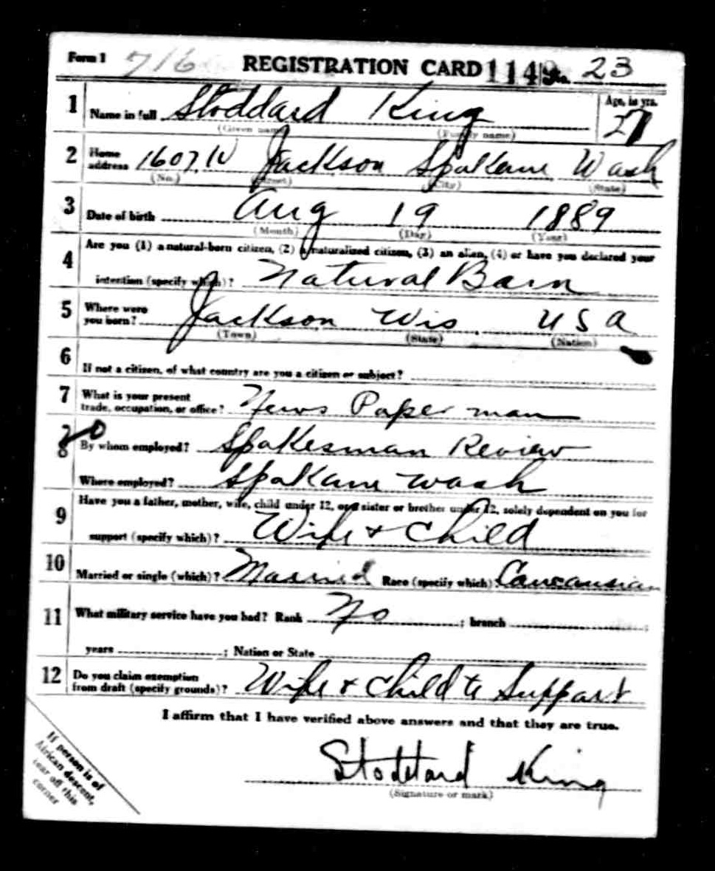
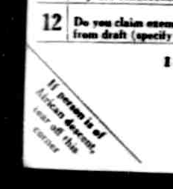
WWI
Draft Card

Slide 36
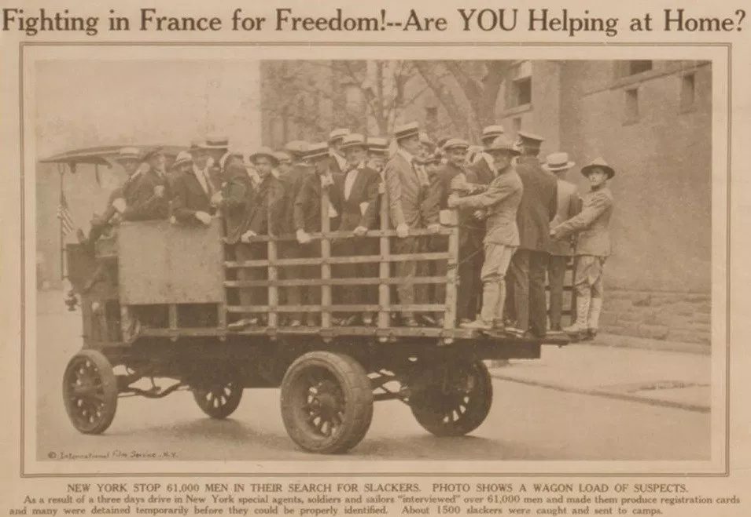

Slide 37
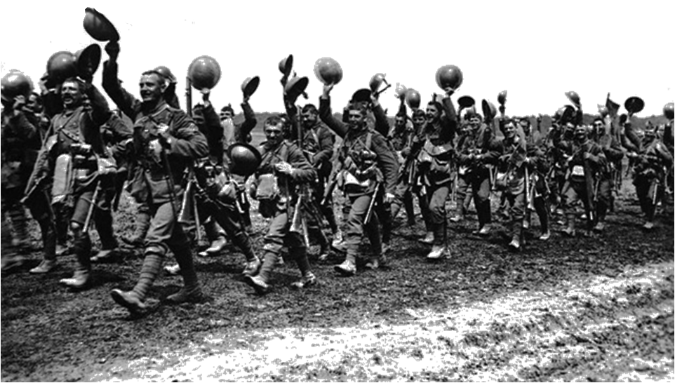
America Enters the War
2.8 million “doughboys” drafted in armed forces
Fresh American troops turn the tide for the Allies
Help lead the final Allied offensives in Summer 1918

Slide 38
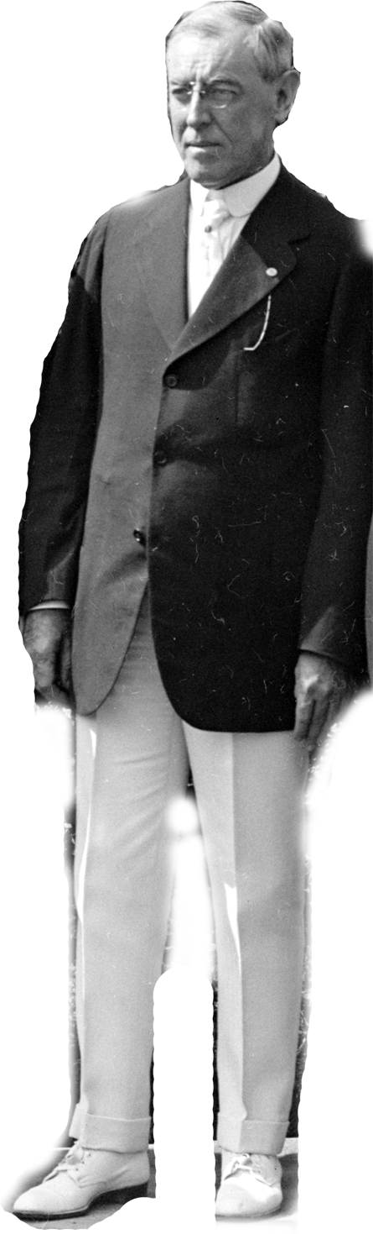
The 14 Points
Woodrow Wilson’s plan for a long lasting peace
Conflicts with Europeans desire to punish Germany

Slide 39
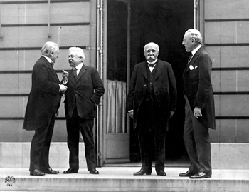
We must punish Germany for this war!

Slide 40


Slide 41

The Treaty of Versailles
Germany…
…forced to accept full responsibility for war
…loses all its territories
…must pay reparation payments to the Allies
… must only have a very limited military

Slide 42

Europe
1914
1924

Slide 43

The Mandate System
Great Britain and France divide up Middle East
British take Iraq, Jordan, and Palestine
France
takes Syria
and
Lebanon

