Slide 1
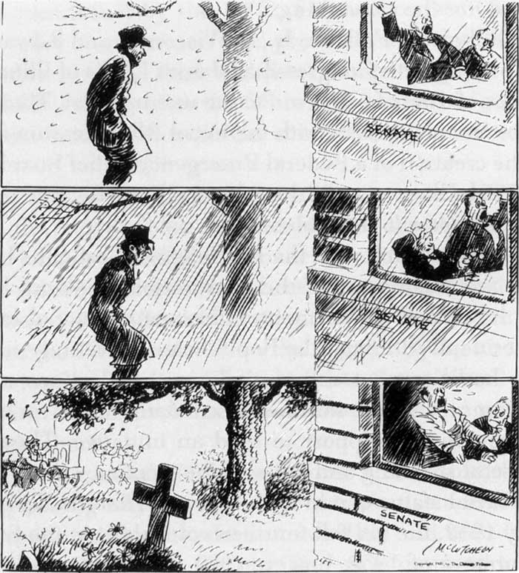
Warm Up
What is the man waiting for?
What is the message of this cartoon?
Could this cartoon be applied to any events recently?

Slide 2
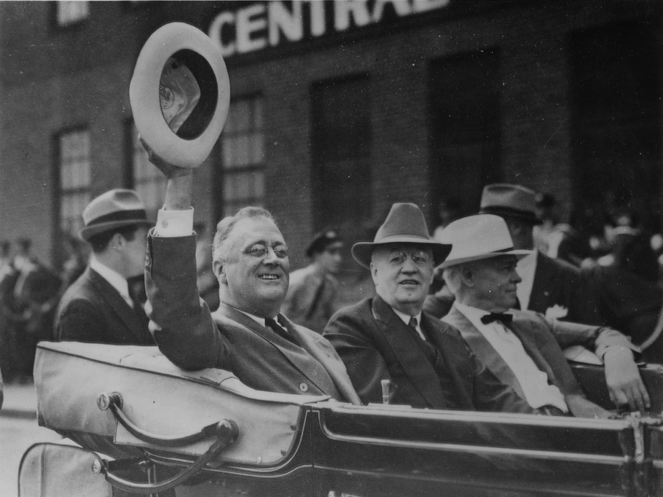
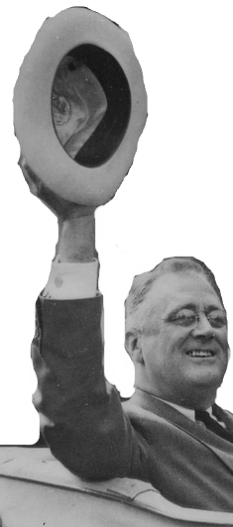

The New Deal &
Great Depression

Slide 3
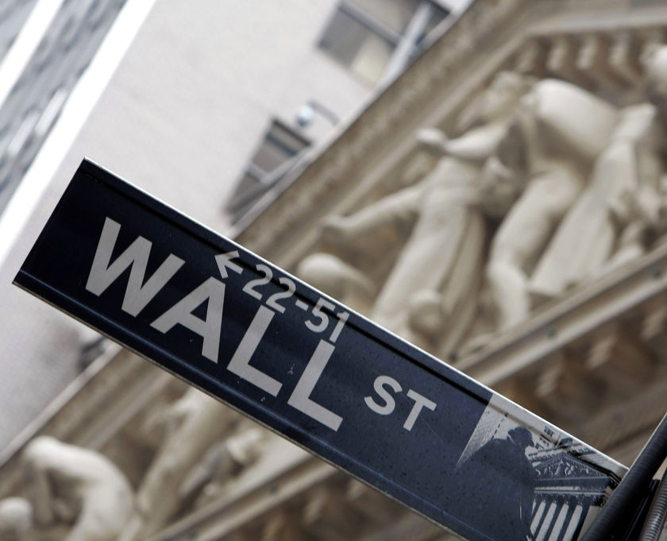
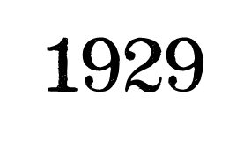
Stock Market Crash
Prices inflated from overspeculation & buying on margin
Stock sell-off spins out of control on Black Tuesday
Billions lost in one day

Slide 4
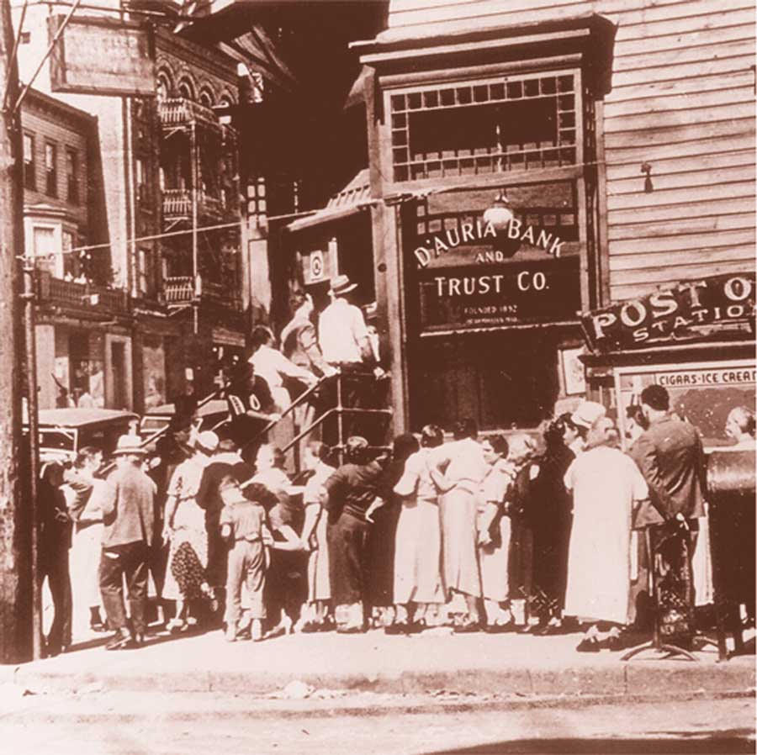
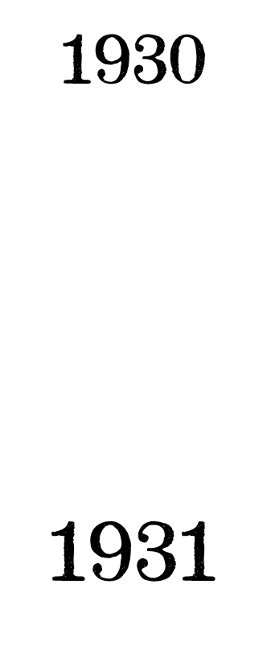
Bank Failures
Fear of closings cause many withdrawals
No insurance against
bank closings
Thousands of banks close

Slide 5
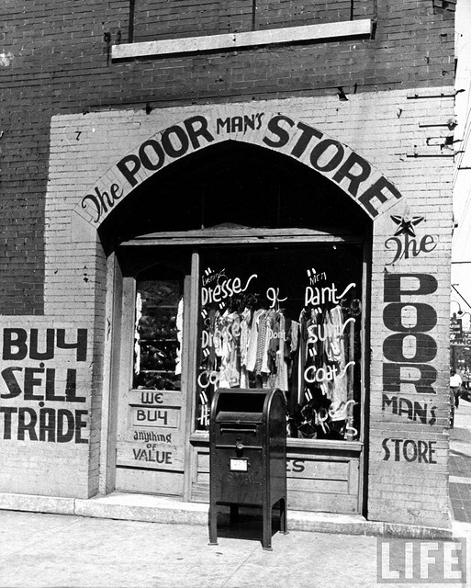

Slide 6
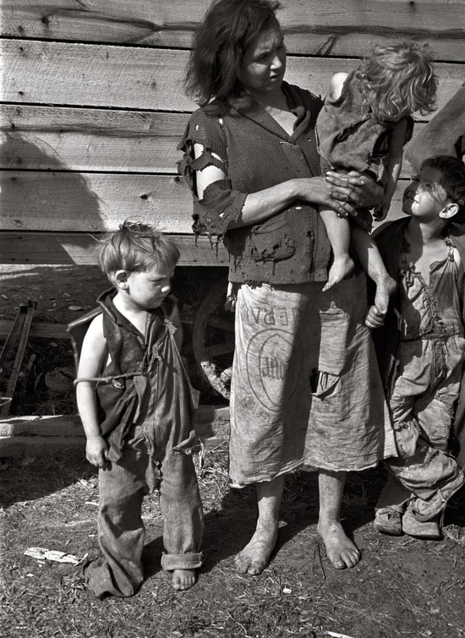

Slide 7
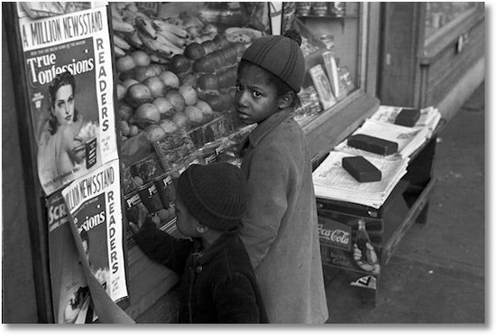

Slide 8
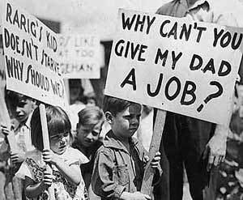

Slide 9
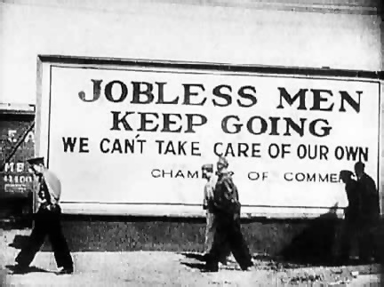

Slide 10
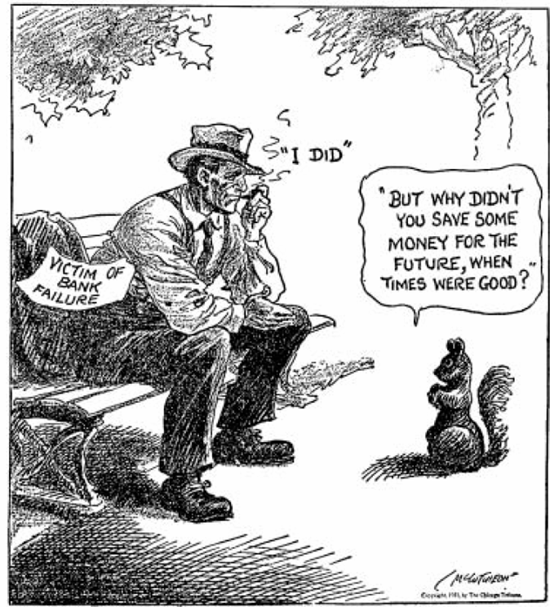

Slide 11
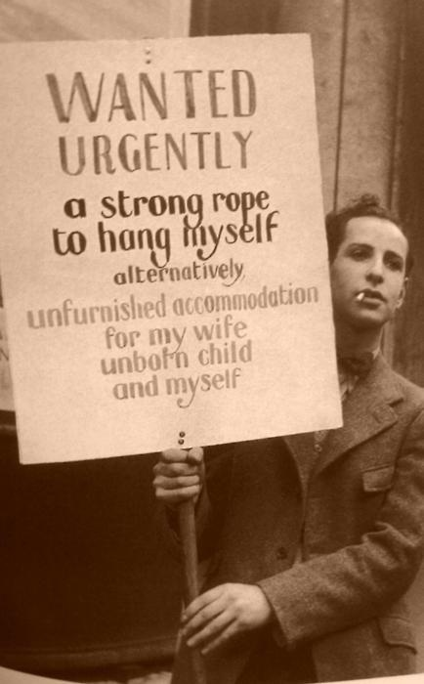

Slide 12
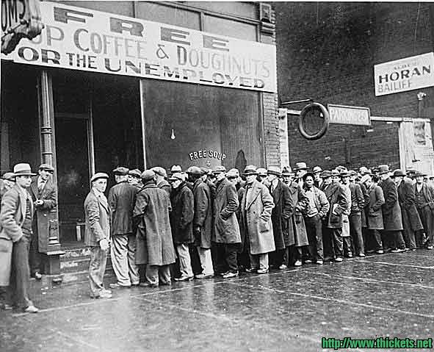

Slide 13
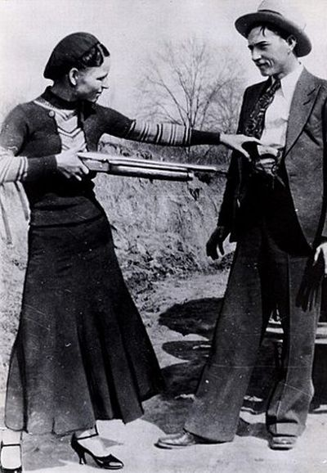
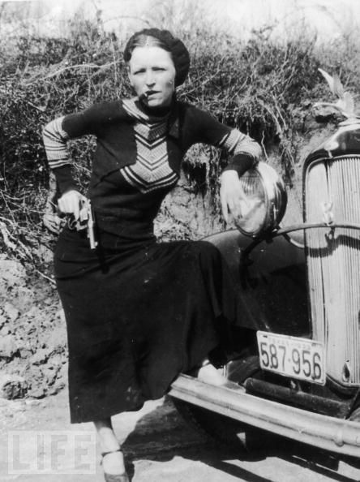
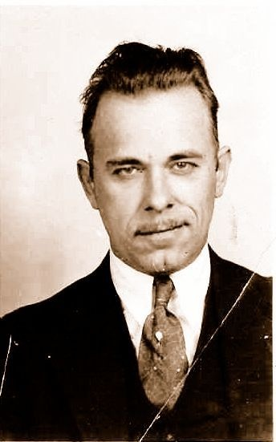

The New Heroes
Bank robbers
Bonnie & Clyde
John Dillinger

Slide 14
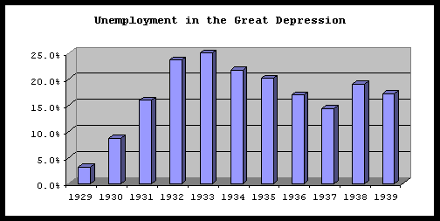

Slide 15
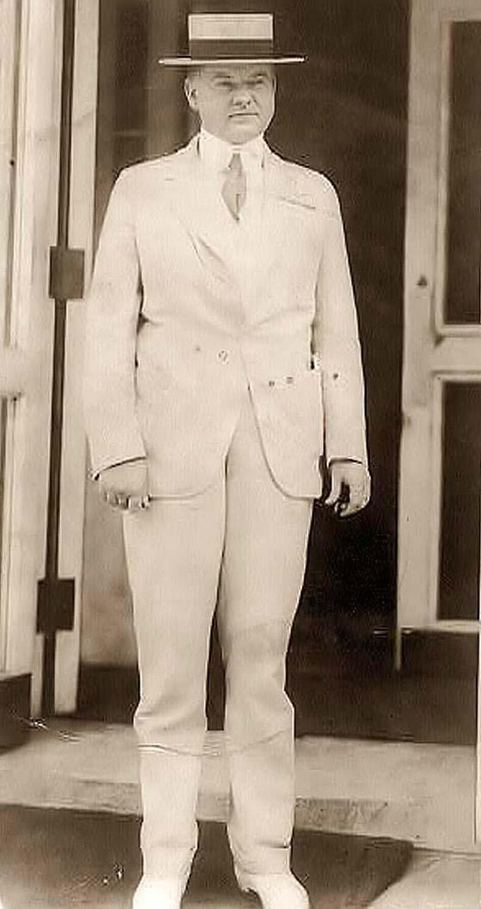
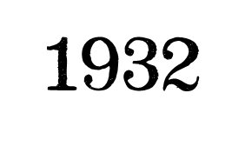
President Herbert Hoover
Does little to stop the Depression
Franklin D. Roosevelt wins 1932 election

Slide 16
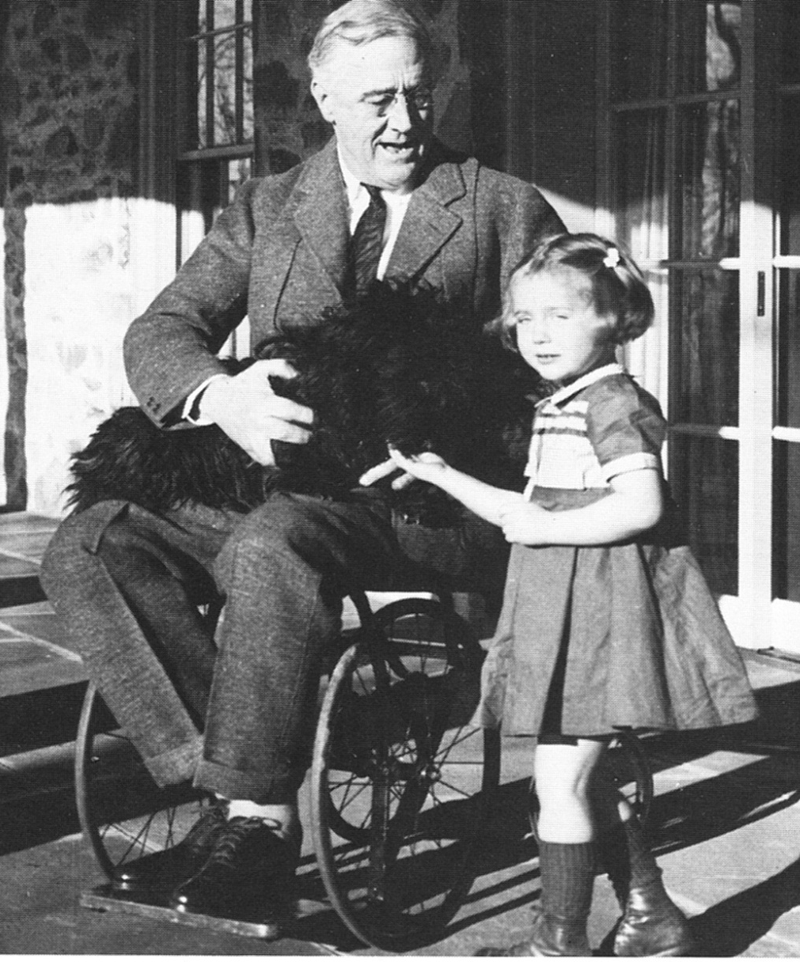
Franklin D. Roosevelt
Democrat from NY
Promises that “Happy Days Are Here Again”

Slide 17
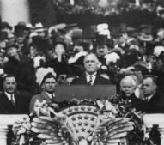
Franklin D. Roosevelt
Starts planning his “first 100 days”
Calls reforms
his “New Deal”
for Americans
Makes a more
active
government
The only thing we have to fear is fear itself!

Slide 18
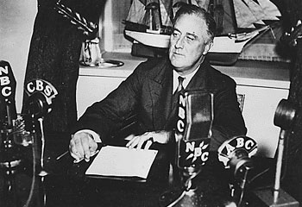
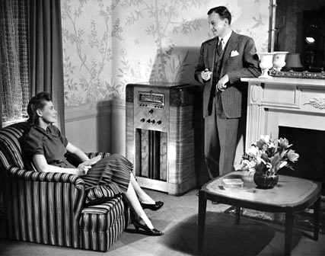
We need Relief, Recovery, and Reform!
Fireside Chats

Slide 19
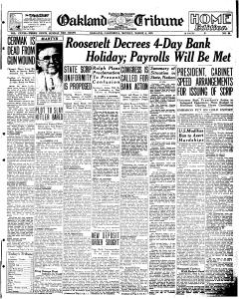
Relief
Immediate help
Money & support
Examples: Bank holiday, Federal Emergency Relief Admin (FERA)

Slide 20
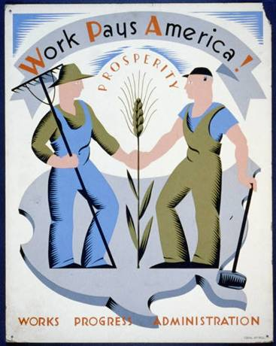
Recovery
Temporary jobs & programs
Restart demand
Examples:
WPA, AAA, TVA, HOLC

Slide 21
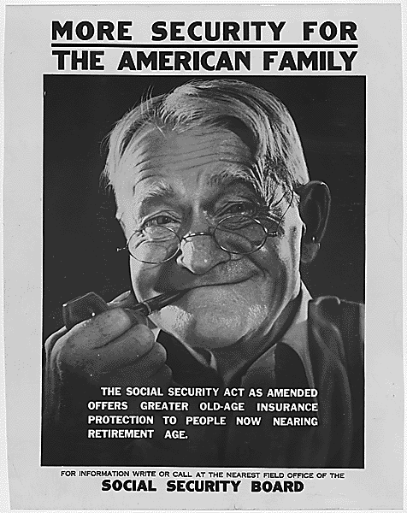
Reform
Changes to laws
Permanent programs to avoid another depression
Examples: FDIC, Social Security, NLRB, SEC

Slide 22
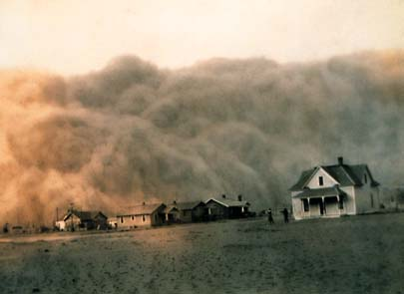

Slide 23
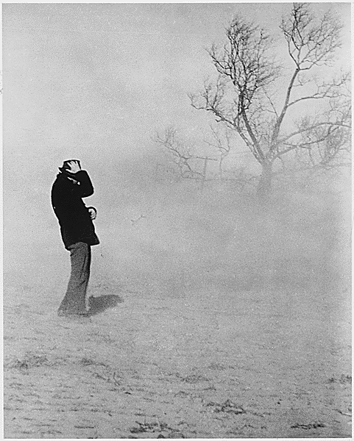
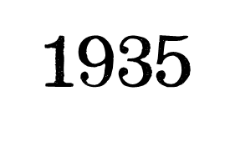
The Dust Bowl
Drought and overfarming dry up land
Huge dust storms spread across the US

Slide 24
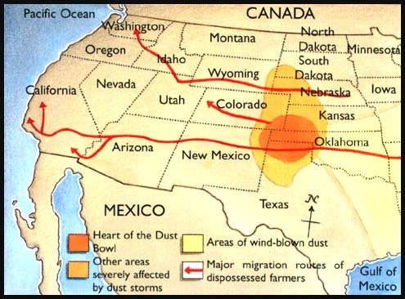

Slide 25
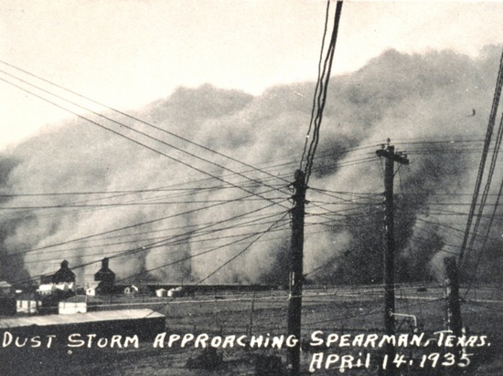

Slide 26
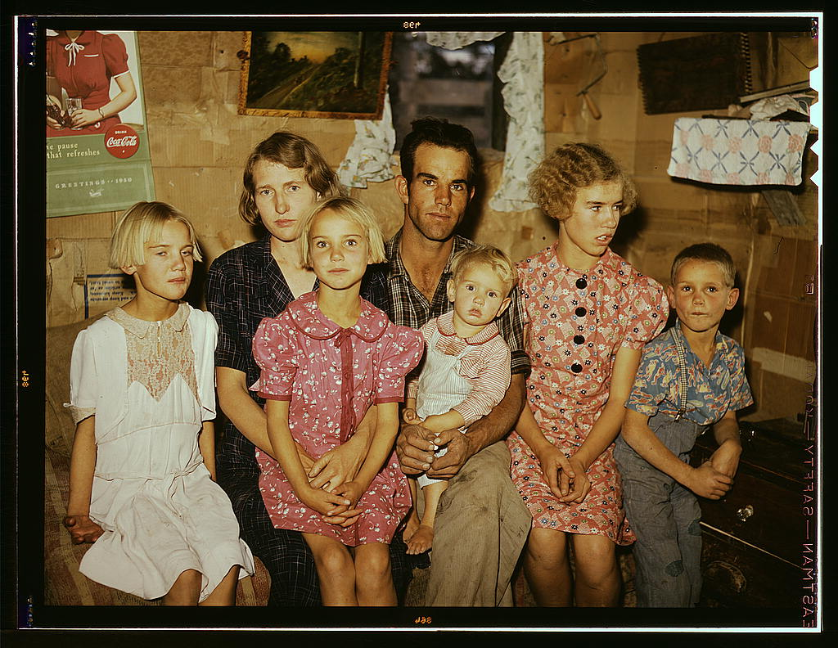

Slide 27
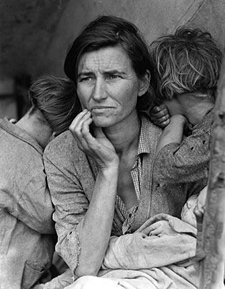
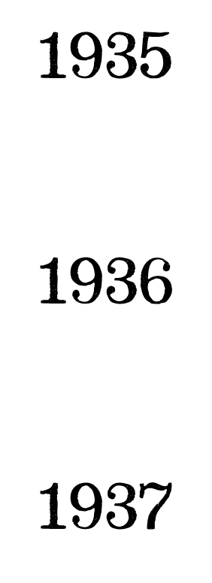
The Second New Deal
More programs after FDR’s reelection

Slide 28
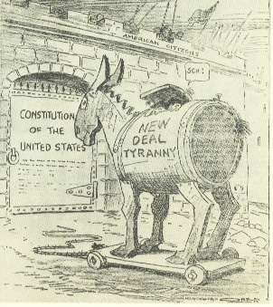
Criticism
BIG government
Deficit spending

Slide 29
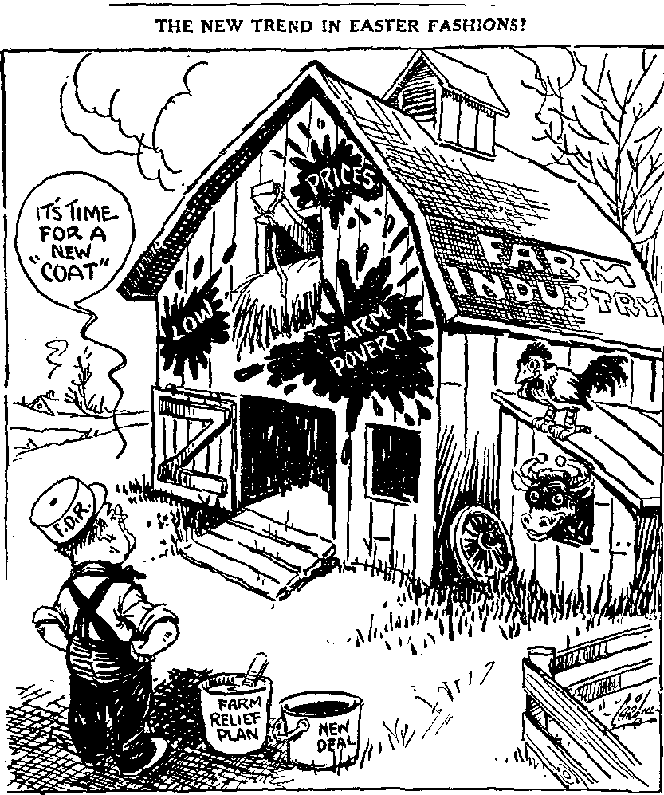
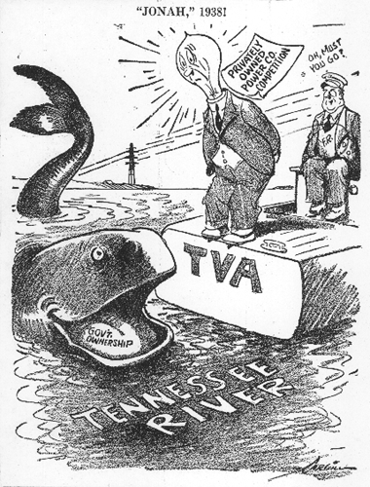

Slide 30
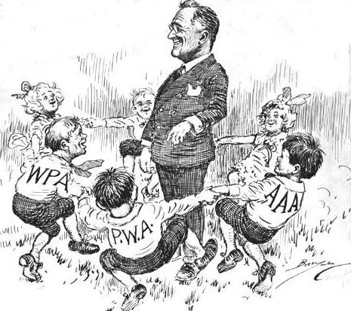
Legacy of the New Deal
Government takes on a larger role in people’s lives
Many programs still in existence today
However, US never fully recovered from Depression until WW2

