Slide 1
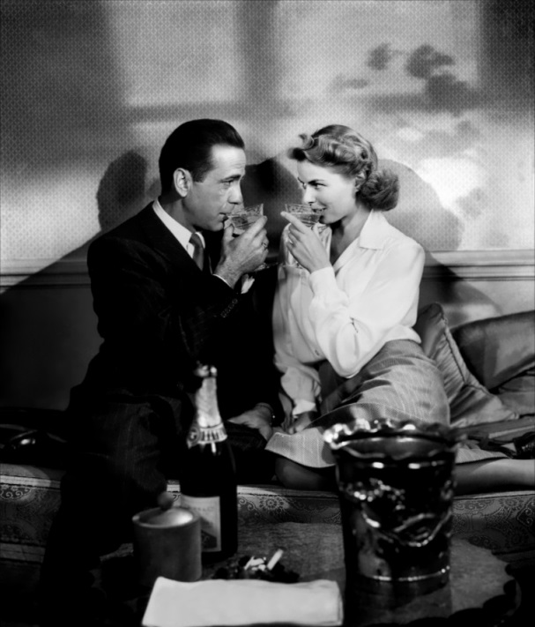
A “War Film”- Casablanca
Casablanca premiered in November 1942, the bombing of Pearl Harbor had already occurred, and the United States had been at war for almost a year.
Department of War established a “War Films” division, and hired filmmakers John Ford, Frank Capra, and Casablanca‘s screenwriters to create a series of seven American war propaganda films, grouped under the umbrella title of Why We Fight

Slide 2

A War Film continued…
The United States served as a foil to the evils of fascism, and was portrayed as a virtuous “safe haven for the oppressed and homeless” — a nation of fearless refuge that anti-Nazi Germans, such as Casablanca‘s Leuchtegs, could honor with a champagne toast.

Slide 3
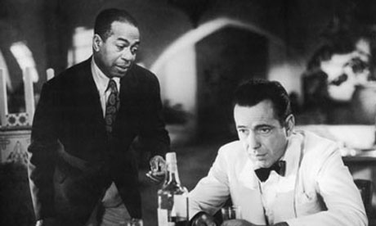
Historical Background Relevant to Casablanca
Since the early 1930s, German refugees (ex. Albert Einstein) had been emigrating to countries such as the USA & Great Britain in an attempt to escape Nazi policies.
When Germany captured France in the summer of 1940, a Nazi-controlled puppet govt. was set up in southern France known as the Vichy Regime.
A flood of refugees from countries invaded by Germany poured into Vichy-controlled Casablanca, Morocco. They hoped to catch a plane or ship to Allied or neutral countries such as Spain or Portugal.

Slide 4
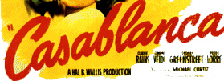
Casablanca presents a political and social commentary on the early days of World War II.
  product of a decade when studios were routinely producing “a movie a week,”
Casablanca exploits wartime patriotism and the traditional “American values” of freedom, liberty, and equality to shape audiences’ perception of the war.
  Casablanca was an anti-fascist propaganda
    designed to support U.S. participation in the Allied Forces’ struggle for global justice and democracy.
    most Americans believed that U.S. foreign policy should have promoted isolationism and neutrality.

Slide 5
Events in France and North Africa Leading up to the film

Slide 6
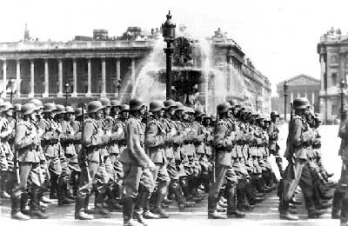
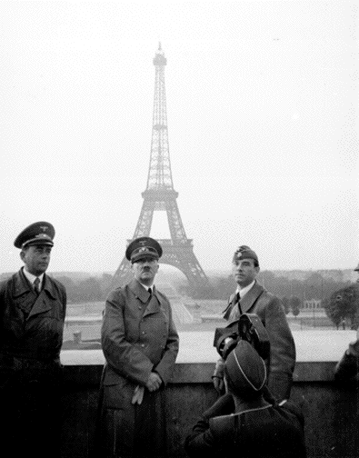
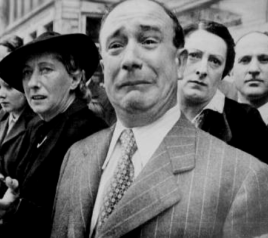
France Surrenders [June, 1940]

Slide 7


Two Different Flags
The Free French
The Vichy Government

Slide 8
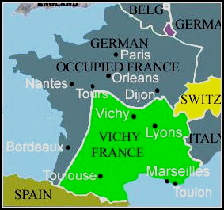
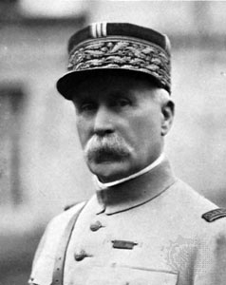
A Divided France
Henri Pétain became the “Traitor of Vichy” during World War II for his collaboration with the occupying forces of Nazi Germany
Henri Petain

Slide 9
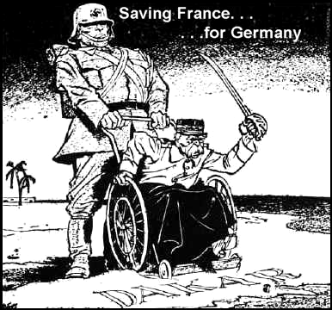
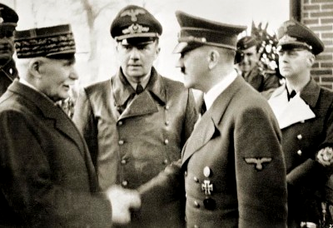
“Saving France for Germany”
Pétain surrendered to Germany on 22 June 1940 and tried unsuccessfully to maintain an independent and collaborative government. The Nazis occupied Vichy in 1942 and in August 1943 Pétain was arrested by the Germans. He was returned to France near the end of the war in April 1945 and was ultimately sentenced to death for treason

Slide 10
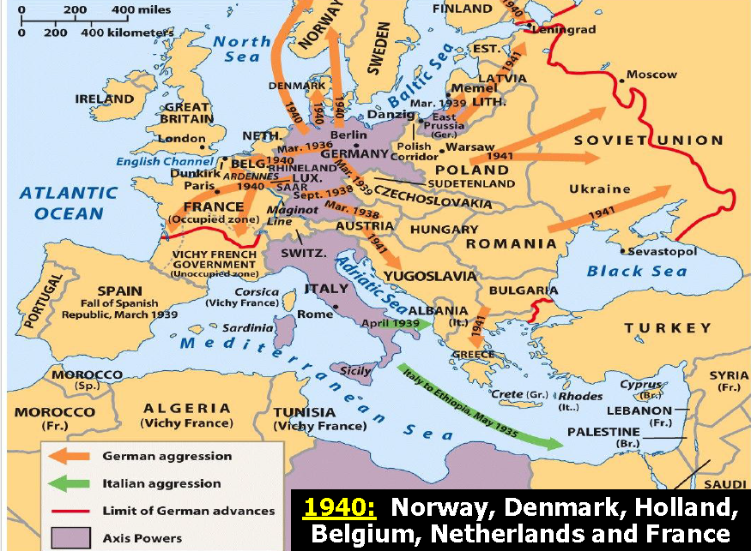

Slide 11
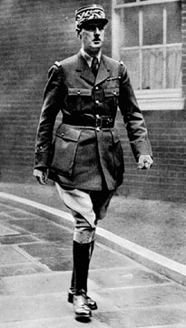
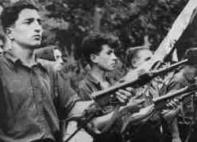
The French Resistance
The Maquis
General Charles DeGaulle

Slide 12
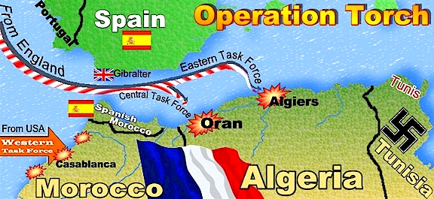
Operation TORCH
Started November 8, 1942

Slide 13
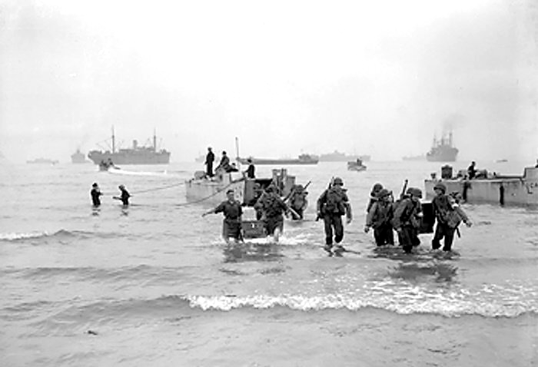
Landing on the Beaches of North Africa

Slide 14
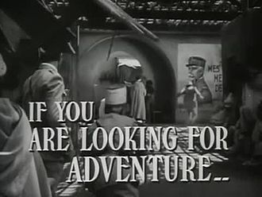

Slide 15
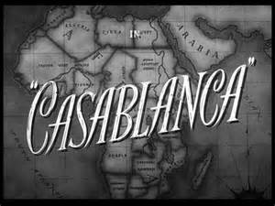

Slide 16
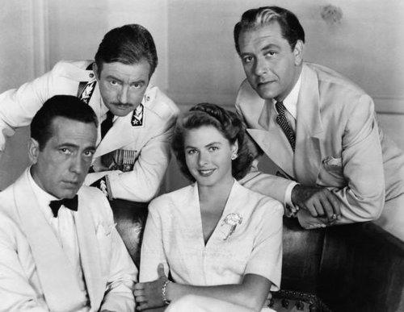
International Affairs
The actors represented a wide-range of nations — all of which, not so surprisingly — were major players in the war:
  Humphrey Bogart was American
  Ingrid Bergman was Swedish
  Conrad Veidt was German
  Paul Heinreid was Austrian
  Claude Rains and Sydney Greenstreet were British.

Slide 17
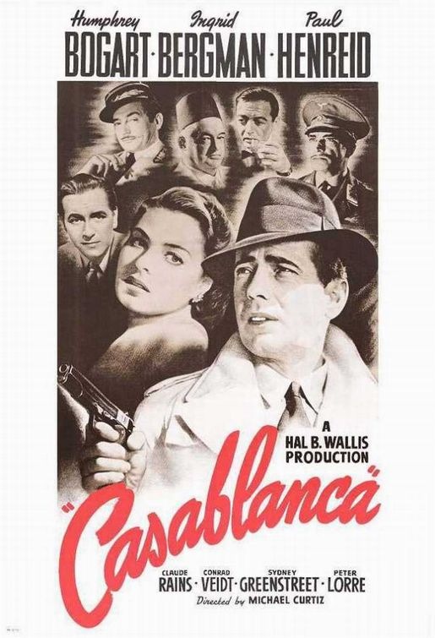
Casablanca
Directed by Michael Curtiz
Starring- Humphrey Bogart as Rick Blaine
Ingrid Bergman as Ilsa Lund
Paul Henreid as Victor Lazalo
3 Academy Awards including Best Picture
At the end, the beginnings of Film Noir

Slide 18
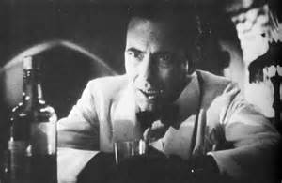
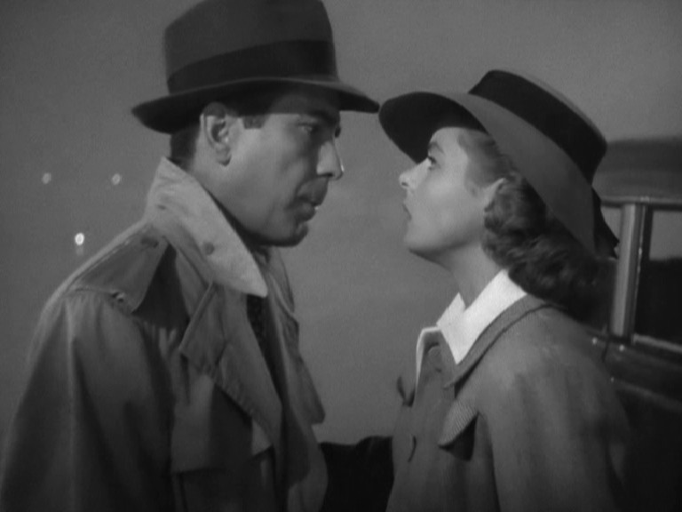
Film Noir
Film noir implies a certain cinematic style: the use of light and shadow, nervous, rapid pacing, nightmare sequences, flashbacks, unwavering, hard-boiled authority figures.
Casablanca opens with a map of the of Africa, noir setting of the entire film — a chaotic and dangerous locale inhabited by a people without hope
  generation of refugees who were forced by the Nazis onto a trail of despair

Slide 19
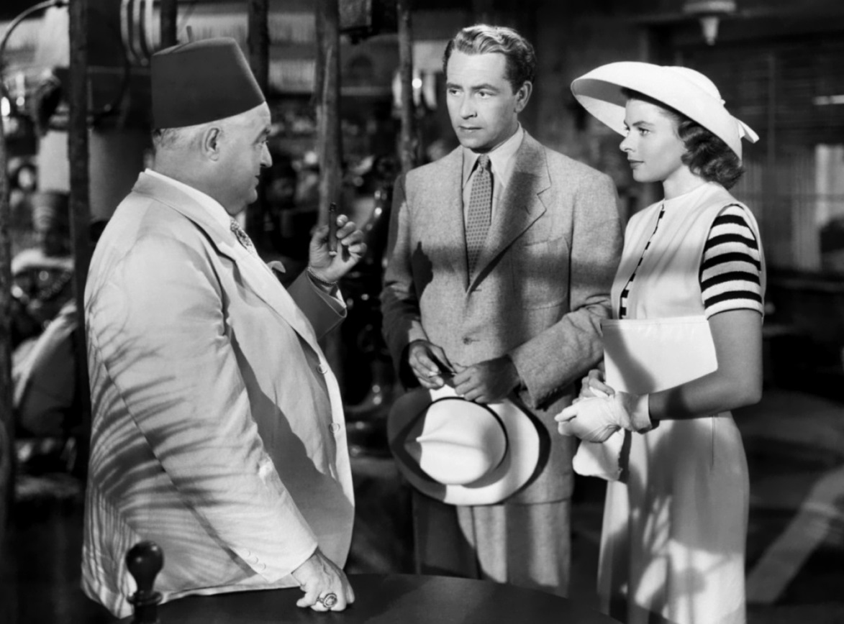
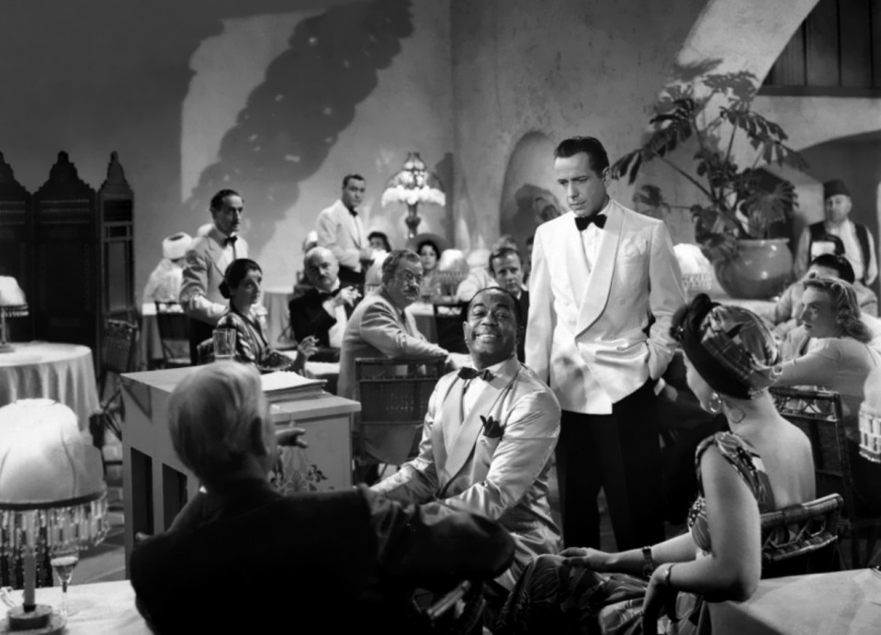
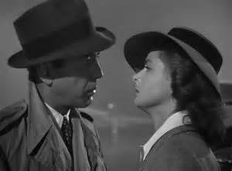

Slide 20

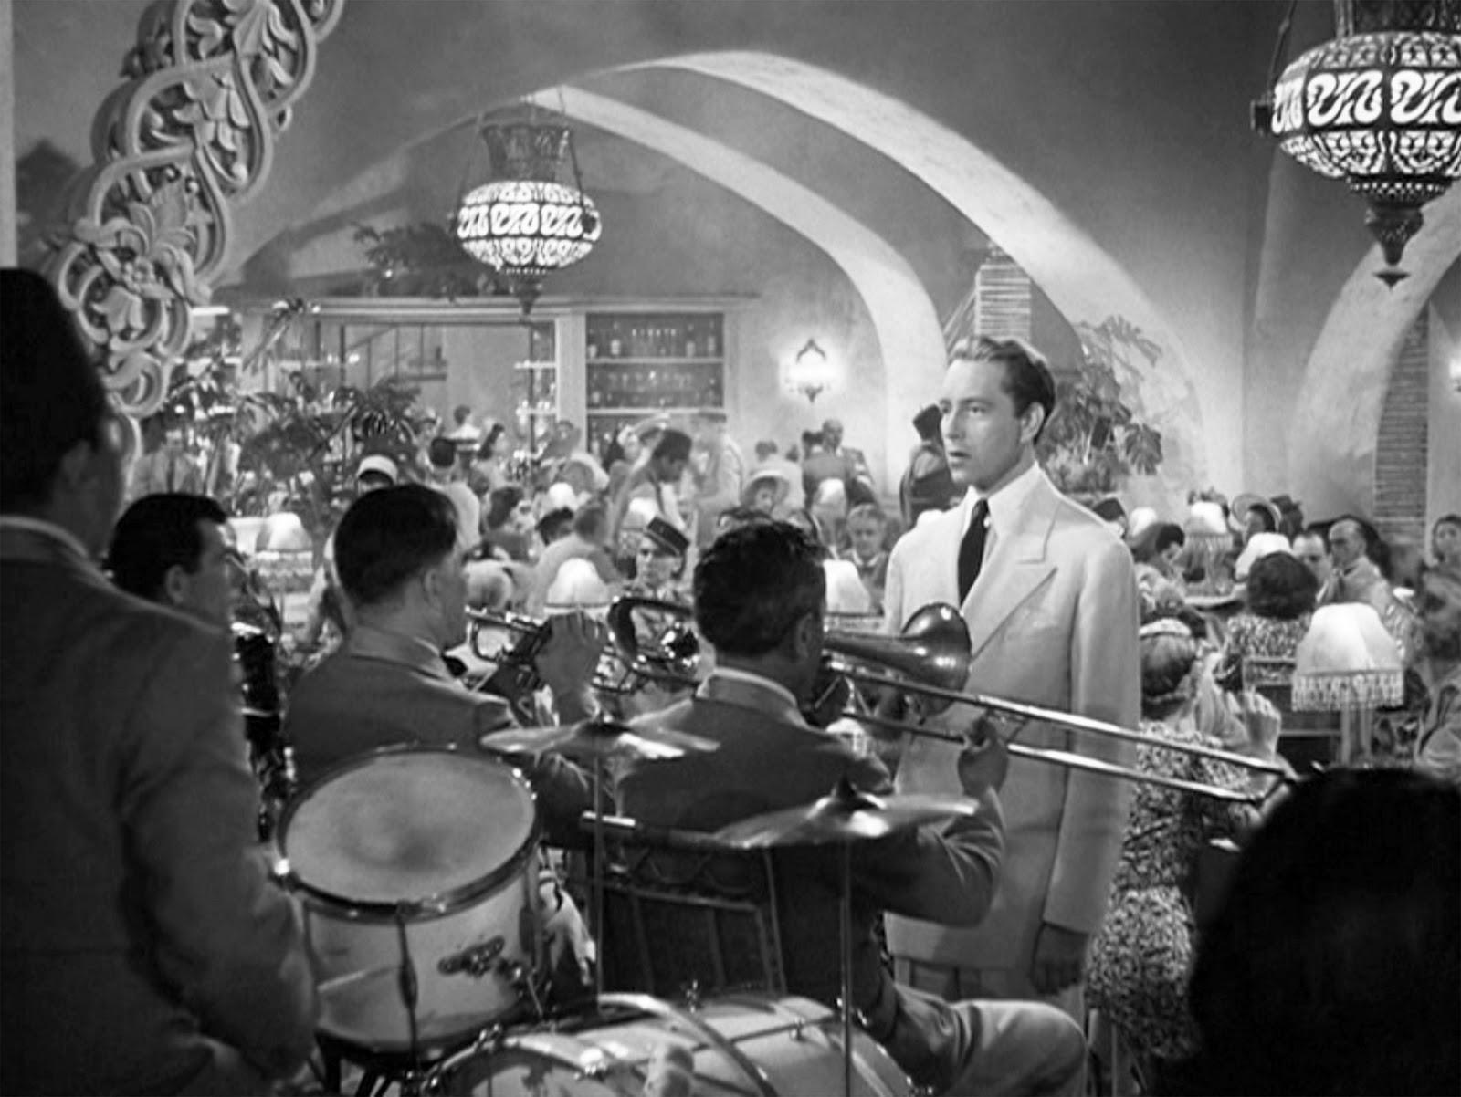
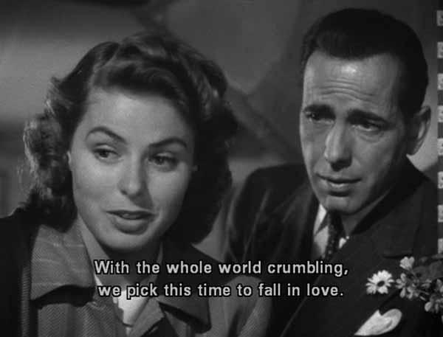

Slide 21
Enjoy the film

Slide 22
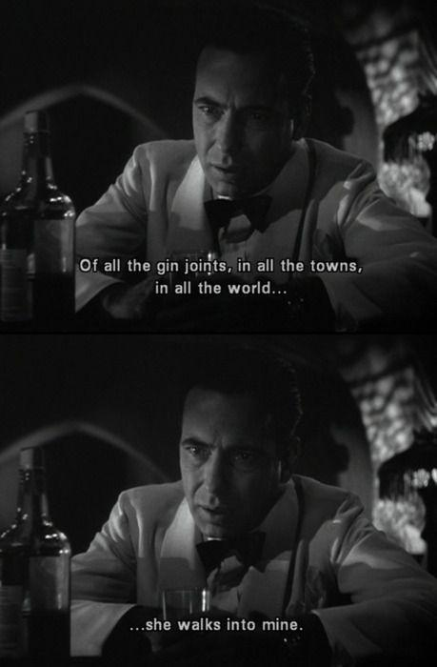

Slide 23
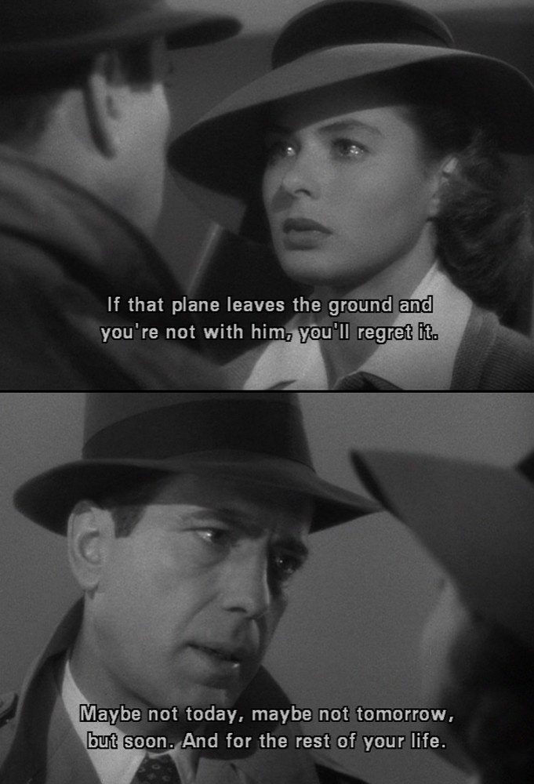

Slide 24
Fun Facts on Casablanca
The premiere was held on November 26, 1942, two weeks after United States troops landed in Casablanca.
• The film went into wide release on January 23, 1943.
MANY of the supporting actors (and extras) were recent émigrés from Nazi occupied Europe.

Slide 25
Casablanca…strange but true
"As Time Goes By" was written by Herman Hupfeld and debuted in 1931's Broadway show "Everybody's Welcome."
It had been a personal favorite of playwright & high school teacher Murray Burnett who, seven years later, visited Vienna just after the Nazis had entered.
After visiting a cafe in south France where a black pianist had entertained a mixed crowd of Nazis, French and refugees, Burnett was inspired to write the melodrama "Everybody Comes To Rick's.”
Rick never says "Play it again, Sam." He says: "You played it for her, you can play it for me. Play it!."
Sam was a professional drummer who faked playing the piano.

Slide 26
Fun Facts: The Airport Scene
The budget was so small they couldn't use a real plane in the background in the airport scene, which was filmed on a studio sound stage. Instead, it is a small cardboard cutout. To give the illusion that the plane was full-sized, they used little people to portray the crew preparing the plane for take-off.

Slide 28
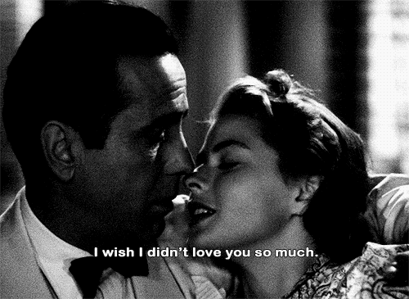

Slide 29
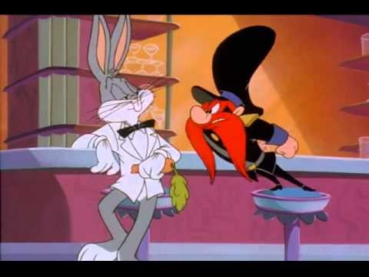
Carrotblanca https://www.youtube.com/watch?v=AdpsiWeKx_A

Slide 30


