Slide 1
1920’s Film: Silent to Talkies

Slide 2
First Film
The Horse in Motion 1878
Created by filming a running horse with a few cameras, then splicing the pictures together.
Made to answer this question: Did a horse’s hooves ever leave the ground at the same time while galloping?
Watch and answer the question.

Slide 3
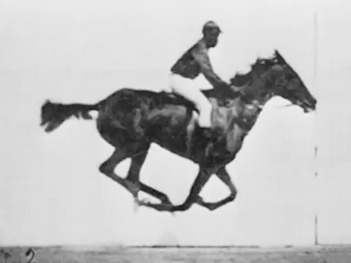

Slide 4
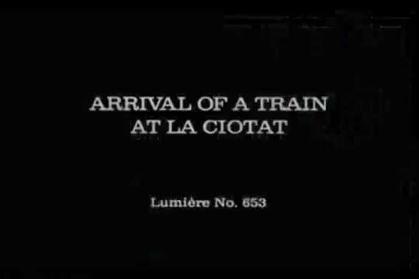
Arrival of a Train at La Ciotat 1896

Slide 5
Silent Movies Entertained the Masses
Eventually, movies evolved to tell actual stories.
The term “silent movies” doesn’t mean there was no sound when you were watching it.
Each movie had someone playing music or making sound effects in the theater while you watched it.
The actors had to portray the story line through their faces and actions, not words.
Movies were in black and white.

Slide 6
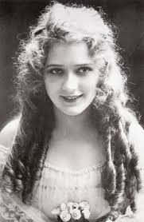
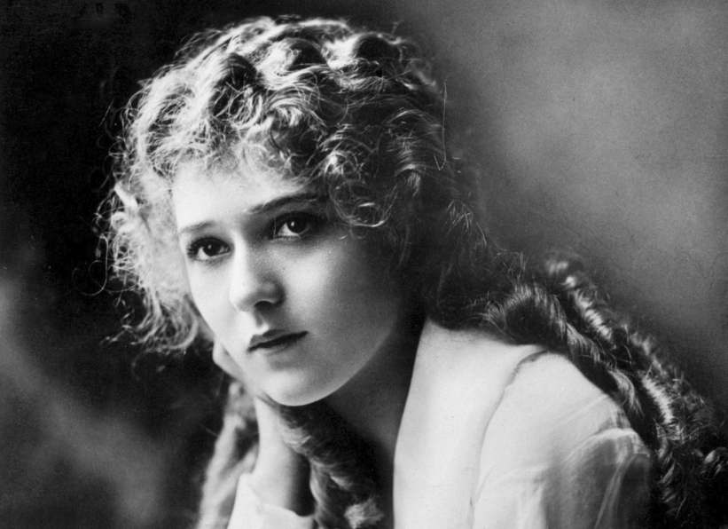
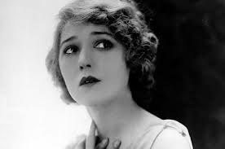
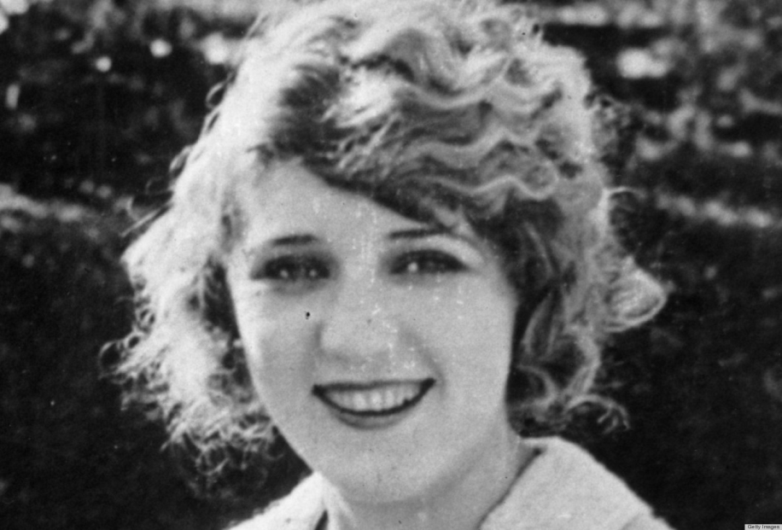
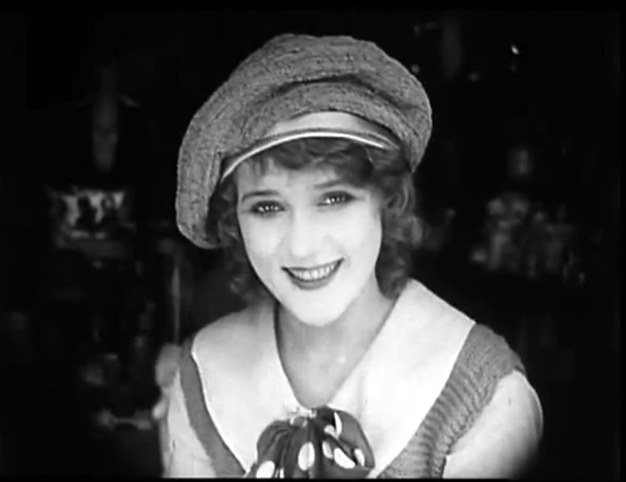
Silent Movie Stars: Mary Pickford

Slide 7
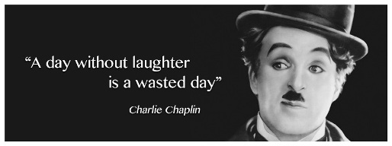
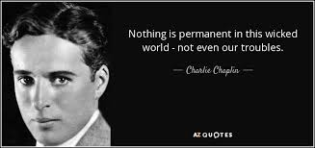
Charlie Chaplin

Slide 8
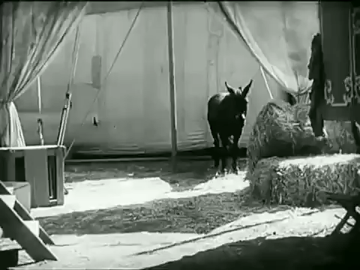
Silent Movie Stars: Charlie Chaplin

Slide 9
You try it!
I will put you in groups of 4 or more.
You will preform a 30 second to 1 minute skit to silent movie music based on the topic I give you.
You have 5 minutes to come up with the skit.
Make it school appropriate.

Slide 10
Silent to Talkies
Thomas Edison tried to connect sound to movies from the very beginning, syncing the phonograph and his version of the movie camera; couldn’t get it to work.
Movies transitioned from silent to “talkies” gradually.
First official “talkie” was The Jazz Singer in 1927.
Movies were never the same again!

Slide 11

The Jazz Singer

Slide 12
Works Cited
http://www.openculture.com/2014/08/watch-the-films-of-the-lumiere-brothers-the-birth-of-cinema-1895.html
https://youtu.be/b6Ppp5902Yg
http://headsup.boyslife.org/what-was-the-first-movie-ever-made/
http://www.filmsite.org/silentfilms.html
https://youtu.be/mpjEyBKSfJQ
https://library.creativecow.net/kaufman_debra/Restoring-Mary-Pickford-Film/1
http://www.feelguide.com/2013/09/25/lost-1911-mary-pickford-moviex-found-in-new-hampshire-barn/
http://www.listal.com/list/happy-birthday-mary-pickford
http://www.huffingtonpost.com/2013/02/13/mary-pickford-douglas-fairbanks-sr-photo_n_2669458.html
https://silentlocations.wordpress.com/2014/02/21/mary-pickford-and-the-silent-stars-meet-at-one-hollywood-corner/
http://www.truecolorsoflife.com/Charlie_Chaplin_Quotes.html
www.azquotes.com
http://birthmoviesdeath.com/2014/08/31/talkie-terror-the-transition-from-silents-to-sound
https://youtu.be/22NQuPrwbHA

