Slide 1
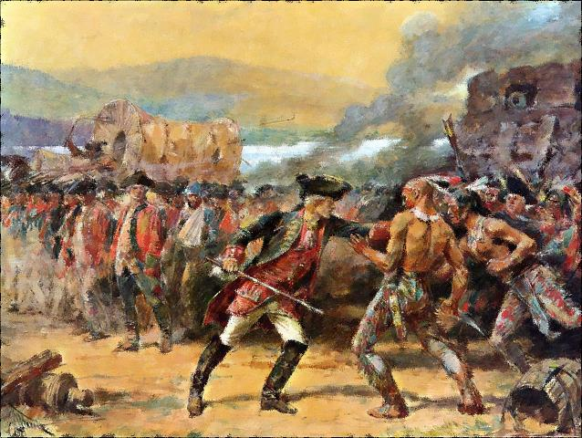



http://www.teacherspayteachers.com/Store/Students-Of-History/

Slide 2

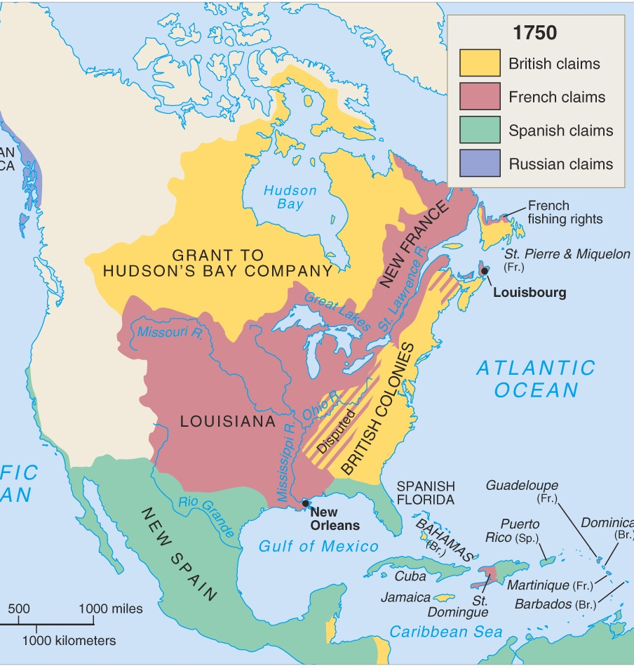

Long-standing rivalry between France & England
War fought in Europe from 1754-1763
Also known as the Seven Years’ War

Slide 3

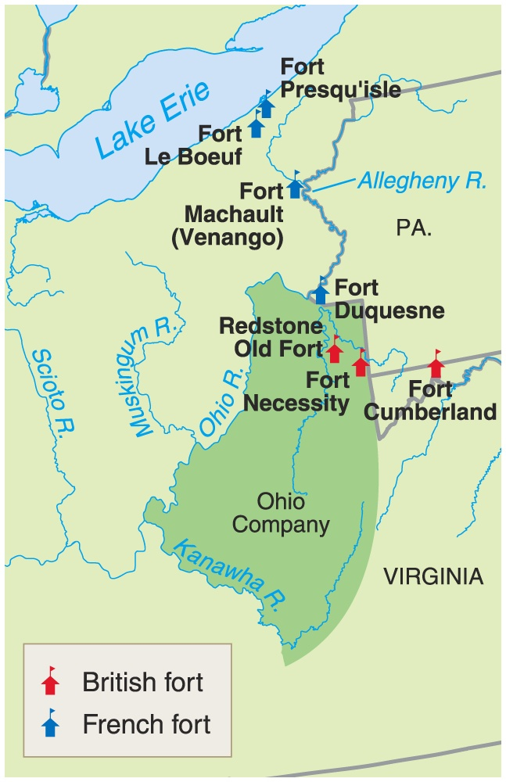
English concerned about French Forts being built by in the Ohio River Valley
Population of English colonies growing rapidly & pushing west

Slide 4

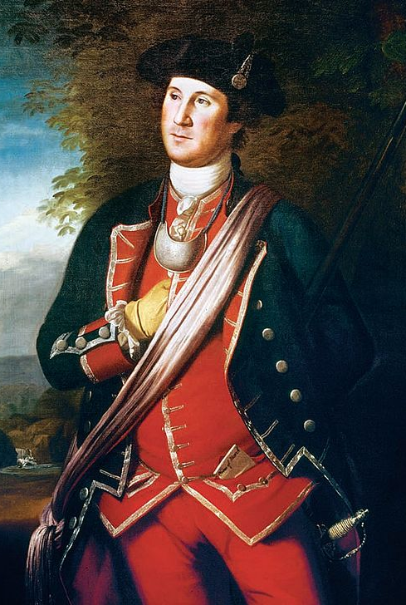
Young Major George Washington leads a small force into Ohio in 1754
Hoped to capture the French Fort Duquesne but defeated and forced to retreat & build Fort Necessity
Defeated by French & Native Americans and forced to return to Virginia

Slide 5

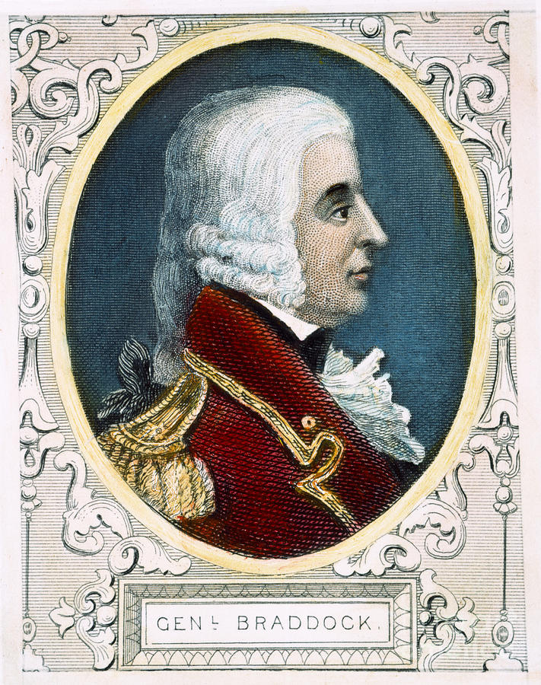
British send General Edward Braddock to drive the French out of the Ohio Valley in 1755
He is defeated and killed soon after by a French & Indian ambush
War officially declared in 1756

Slide 6



England France
Allies Iroquois Algonquins, Hurons,
Ottowas
Colonial
Population 1,000,000 70,000
Colonial Towns, trade, farms Fur trading, missionary
Activities priests

Slide 7

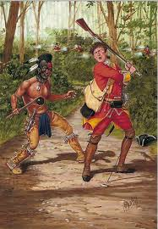
French capture British forts at Lake Ontario and Lake George
France’s Native American allies raid farms from the New York Virginia frontiers
British settlers’ farms & houses burned and many families flee to the east coast

Slide 8
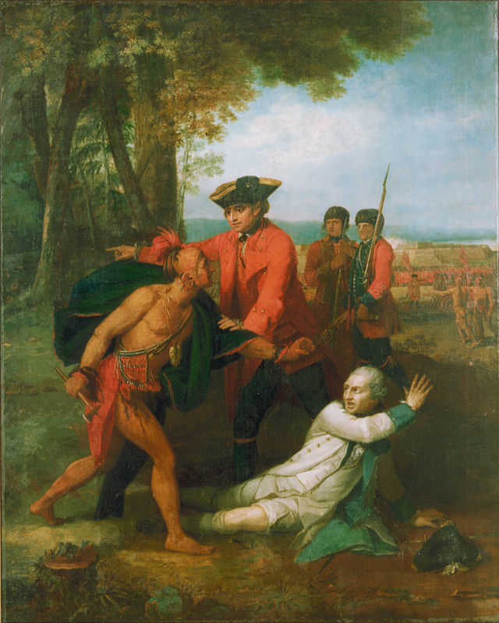
France & allies dominate the first 3 years of the war
Win major victories at Fort Oswego, Ticonderoga, & Fort William Henry

Slide 9

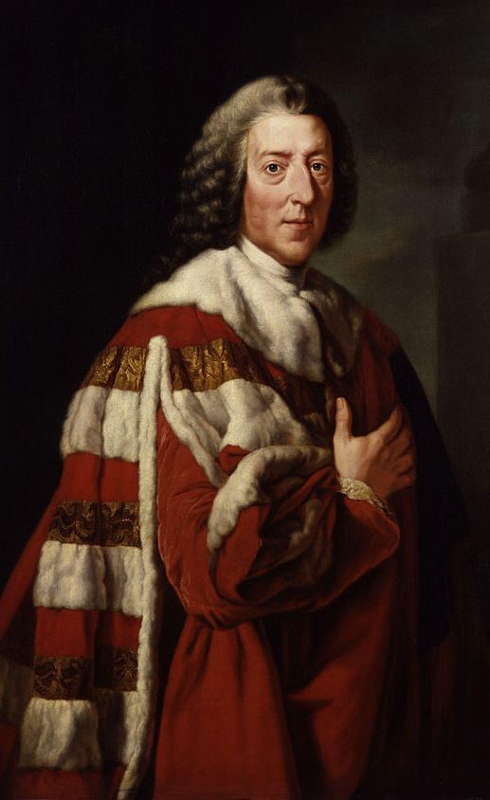
British Foreign Minister William Pitt helps turn the tide in 1758
Makes peace with important Indian allies & adopts Indian fighting strategies

Slide 10
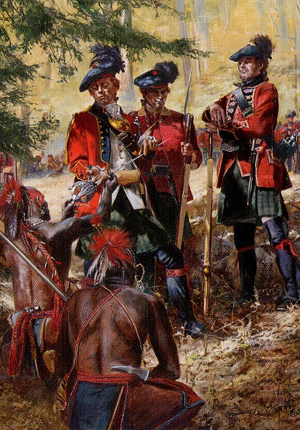


In September 1759, British General James Wolfe leads a surprise attack on Quebec
British victory at Fort Niagara cut off the French frontier forts
Leads England to eventual victory in the war

Slide 11

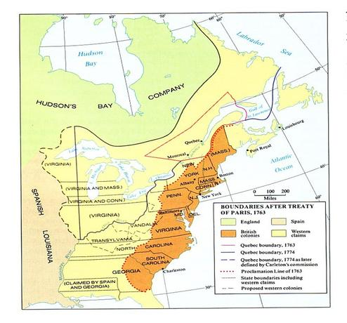
France lost Canadian colonies and claims to land east of the Mississippi River
England got all French territory in Canada, Florida & rights to Caribbean slave trade
Spain got French territory west of the Mississippi River & New Orleans

Slide 12
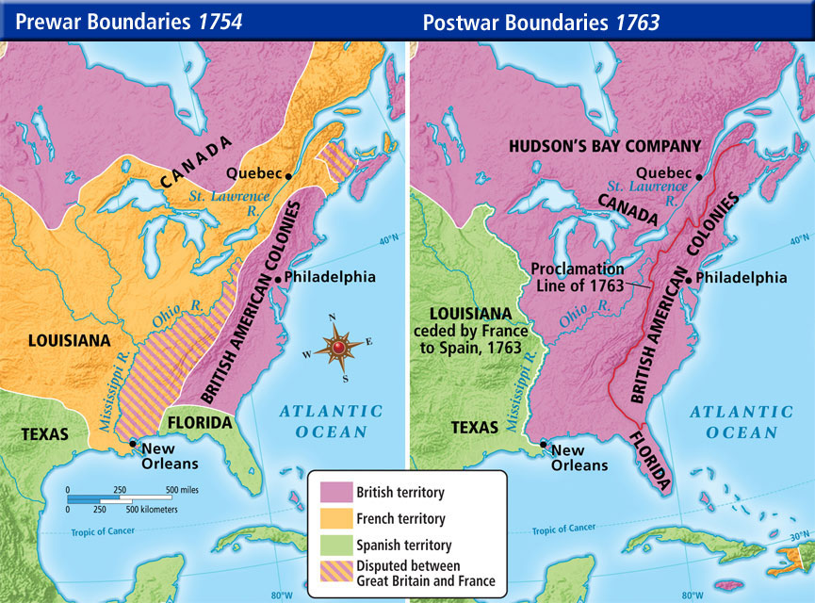

Slide 13

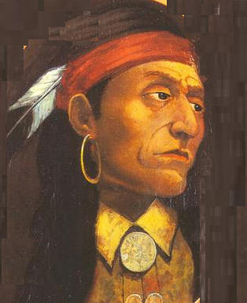
Chief Pontiac forms a Native American Alliance and strikes back at the British
Pontiac’s War ends in 1765
England issues the Proclamation of 1763 to prevent further westward expansion & issues new taxes on colonies to pay for the war
Friction increases between colonies & Great Britain

Slide 14
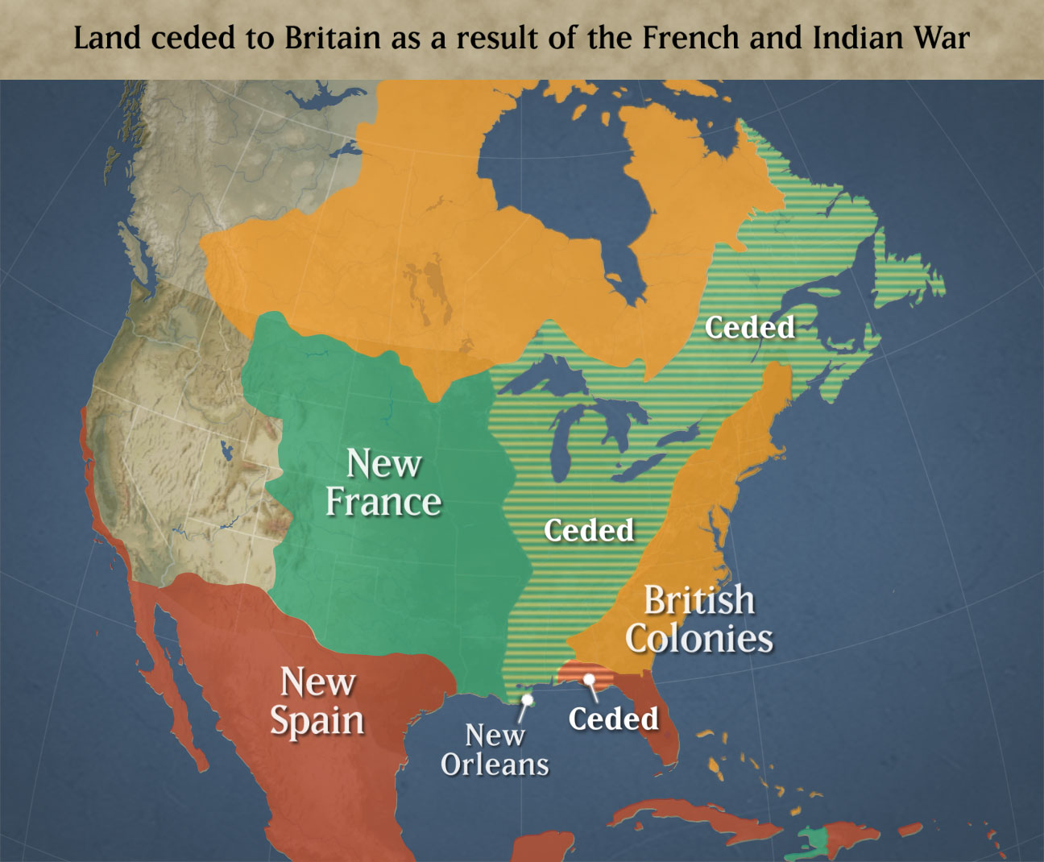
Exit Ticket
The French and Indian War
The word “ceded” most likely means:
  Independent
  Destroyed
  Awarded to
  Explained
  2. What are some current US states in the ceded territory?
  3. What line separated the British Colonies from the land ceded to them?
© Students of History - http://www.teacherspayteachers.com/Store/Students-Of-History

Slide 15

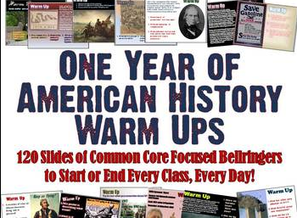

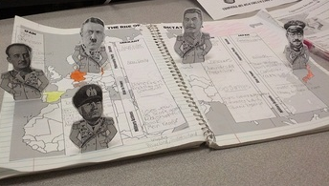
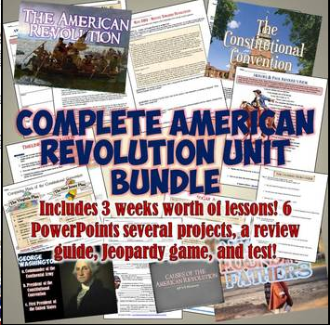
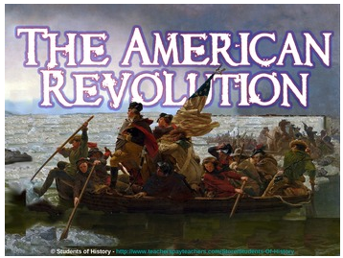
Thank you so much for your purchase!
Please visit my store for more great Social Studies resources – including more Magic Portraits, Daily Warm Ups, PowerPoints in 3D, Interactive notebook Pop-Ups, Reading guides, Unit Plans, and more!!!
http://www.teacherspayteachers.com/Store/Students-Of-History

